Slide 1
Overview plot with all stations

Slide 2
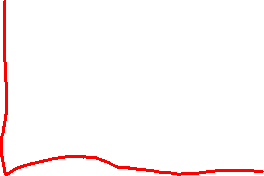
12 methods to calculate VP rates;
Linear Regression through all points (LM_AP):
Lysogeny calculated by subtracting slopes of VPC and VP.
Linear Regression through separate replicates (LM_SR_AVG):
3 slopes each for VP and VPC.
These slopes are averaged and subtracted to get lysogeny
Linear Regression through averaged replicates per time point (LM_AR):
VP and VPC replicates per timepoint are averaged and slopes are calculated through the means of every timepoint.
Lysogeny is calculated by subtracting
Linear Regression through averaged replicate, after calculating difference curve (LM_AR_Diff)
Every timepoint is averaged, for VP and VPC.
Diff curve is calculated by subtracting per timepoint.
Linear Regression through averaged replicate after calculating difference curve via LMER (LM_AR_Diff_LMER)

Slide 3
12 methods to calculate VP rates;
VIPCAL though separate replicates (VPCL_SR_AVG)
Three VPCL calculations each for VP and VPC.
Averaged and then subtracted to calculate lysogeny
VIPCAL through averaged replicate – No standard error calculation – (VPCL_AR_No_SE)
Difference curve wasn’t calculated. VPC and VP were subtracted to calculate lysogeny.
8. VIPCAL through averaged replicate – No Std error – Diff curve was calculated – (VPCL_AR_Diff_No_SE)
VIPCAL through averaged replicate – Std error consideration – (VPCL_AR_SE)
VIPCAL through averaged replicates – Std error and difference curve (VPCL_AR_SE_Diff)
VIPCAL through avergaed replicate – difference curve calculated using LMER – No SE consideration (VPCL_AR_Diff_LMER_No_SE)
VIPCAL through averaged replicate – difference curve calculated using LMER – SE (VPCL_AR_Diff_LMER_SE)

Slide 4
12 methods to calculate VP rates;
LM_AP
LM_SR_AVG
LM_AR
LM_AR_Diff
LM_AR_Diff_LMER
VPCL_SR_AVG
VPCL_AR_SE
VPCL_AR_Diff_SE
VPCL_AR_No_SE
VPCL_AR_Diff_No_SE
VPCL_AR_Diff_LMER_No_SE
VPCL_AR_Diff_LMER_SE

Slide 5
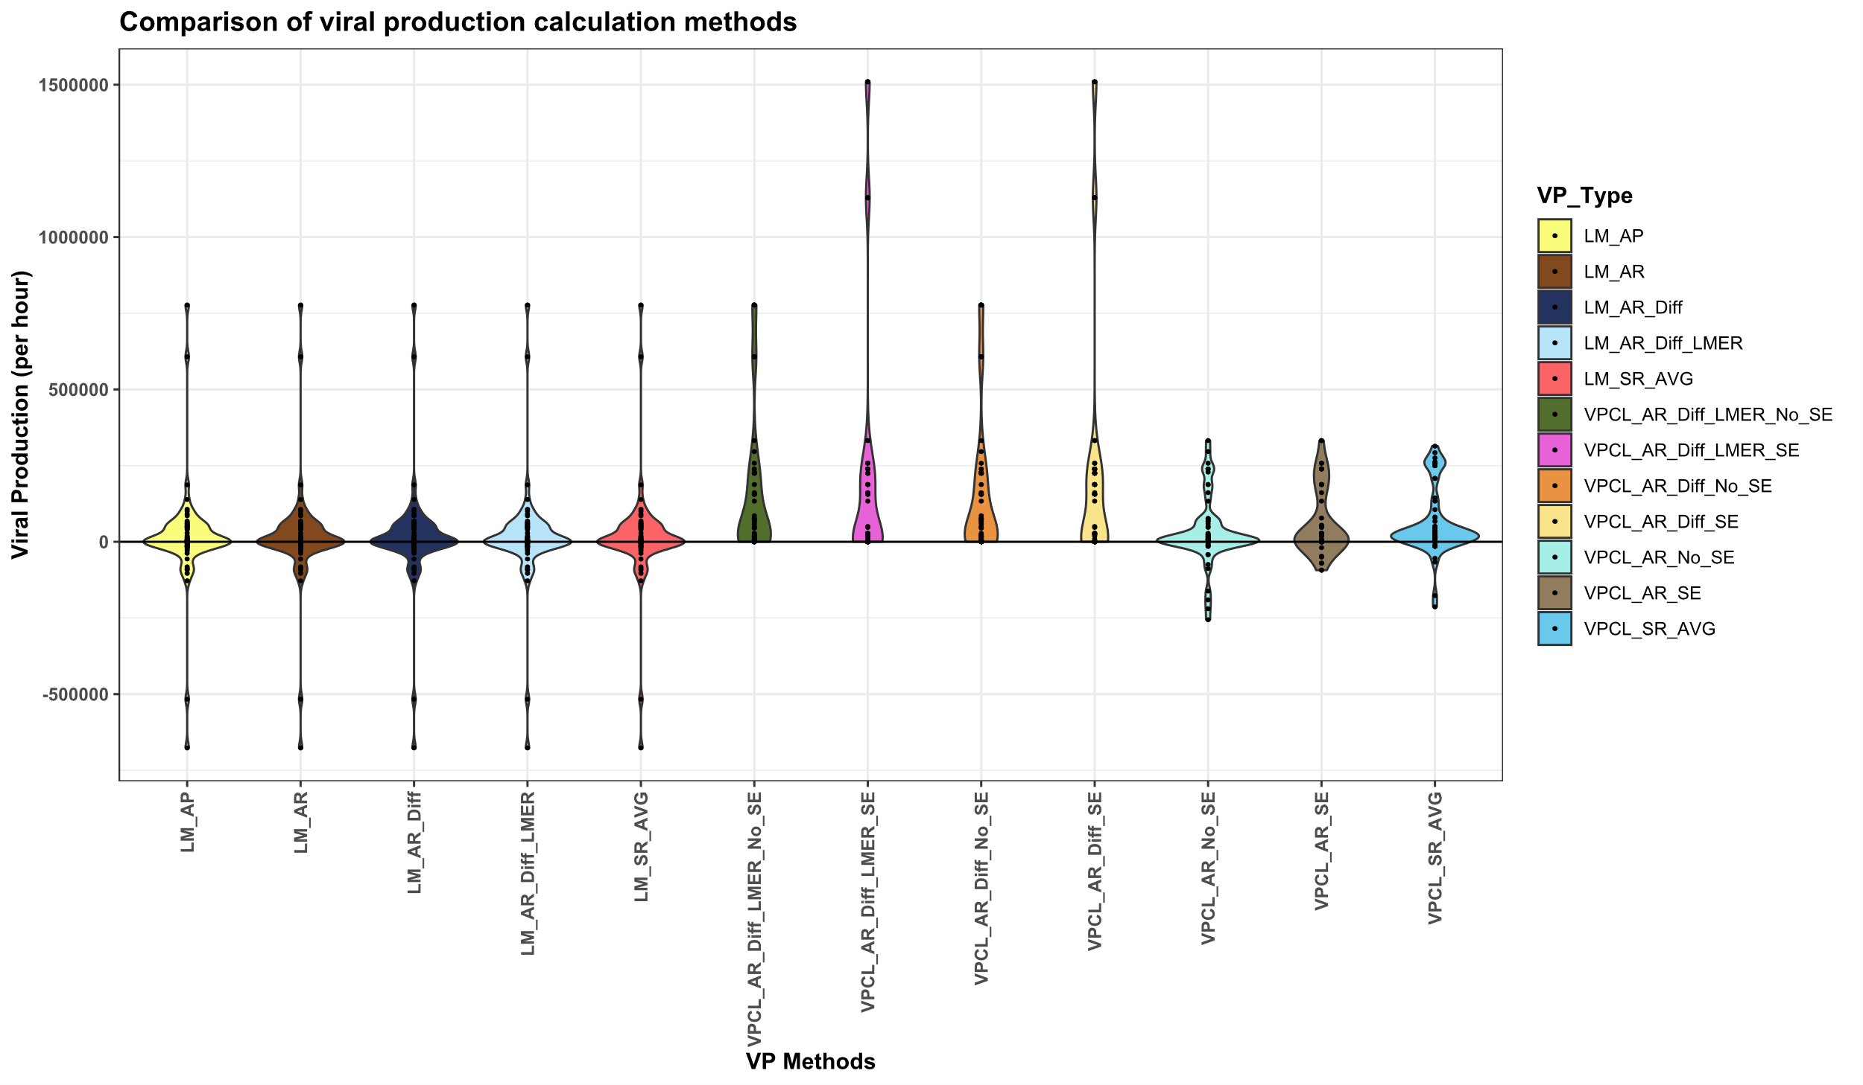

Slide 6
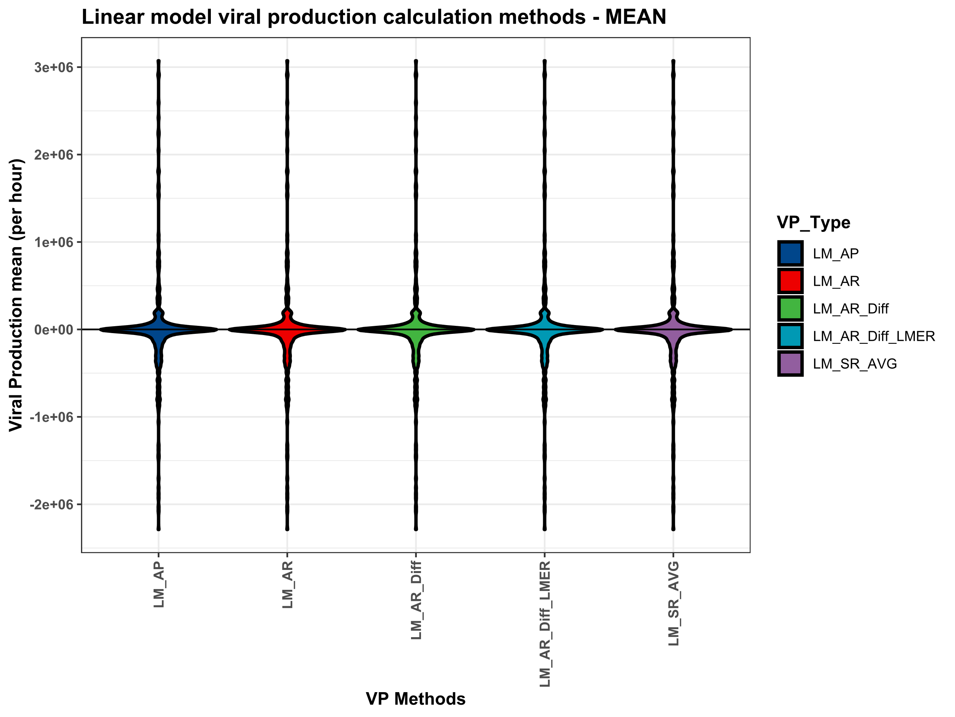
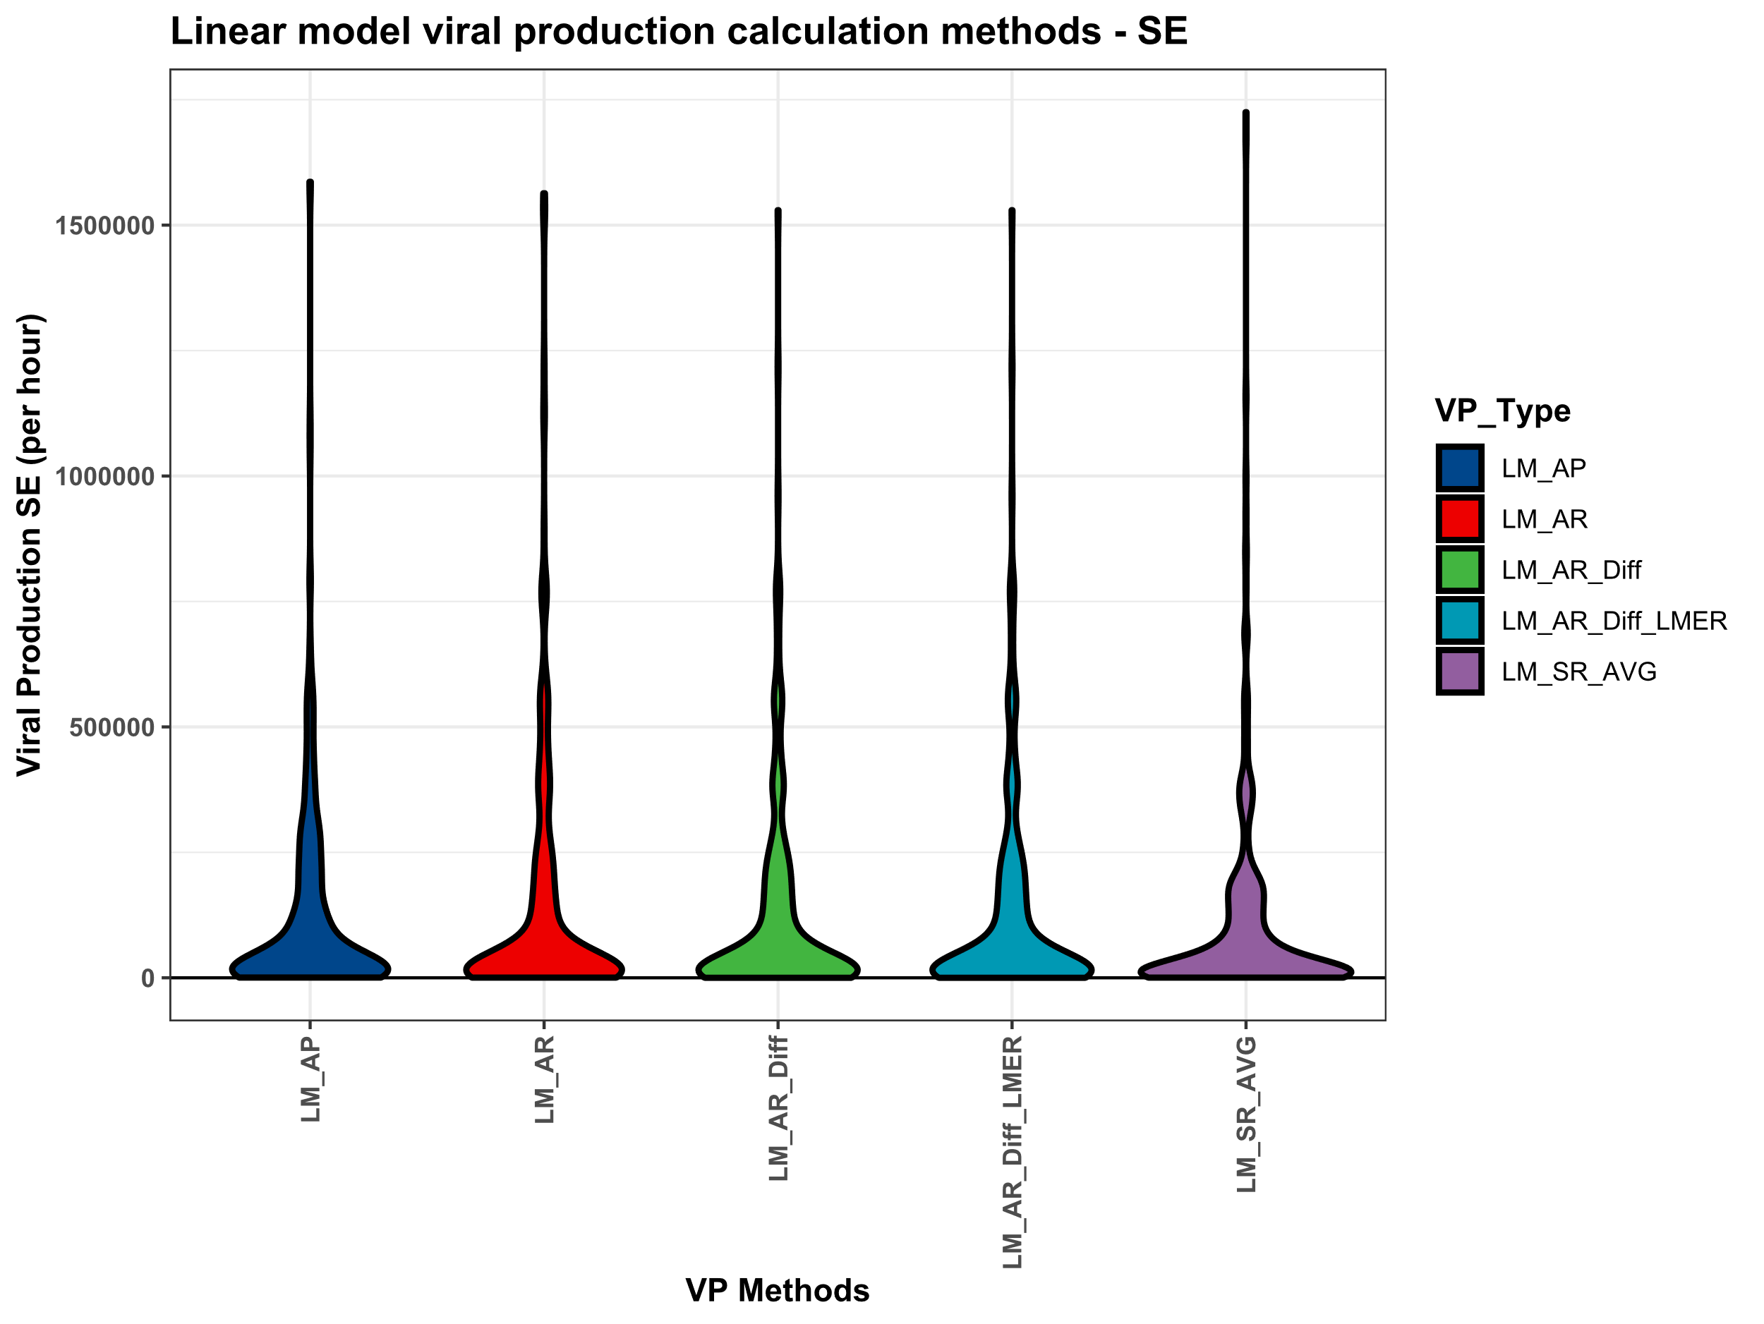

Slide 7
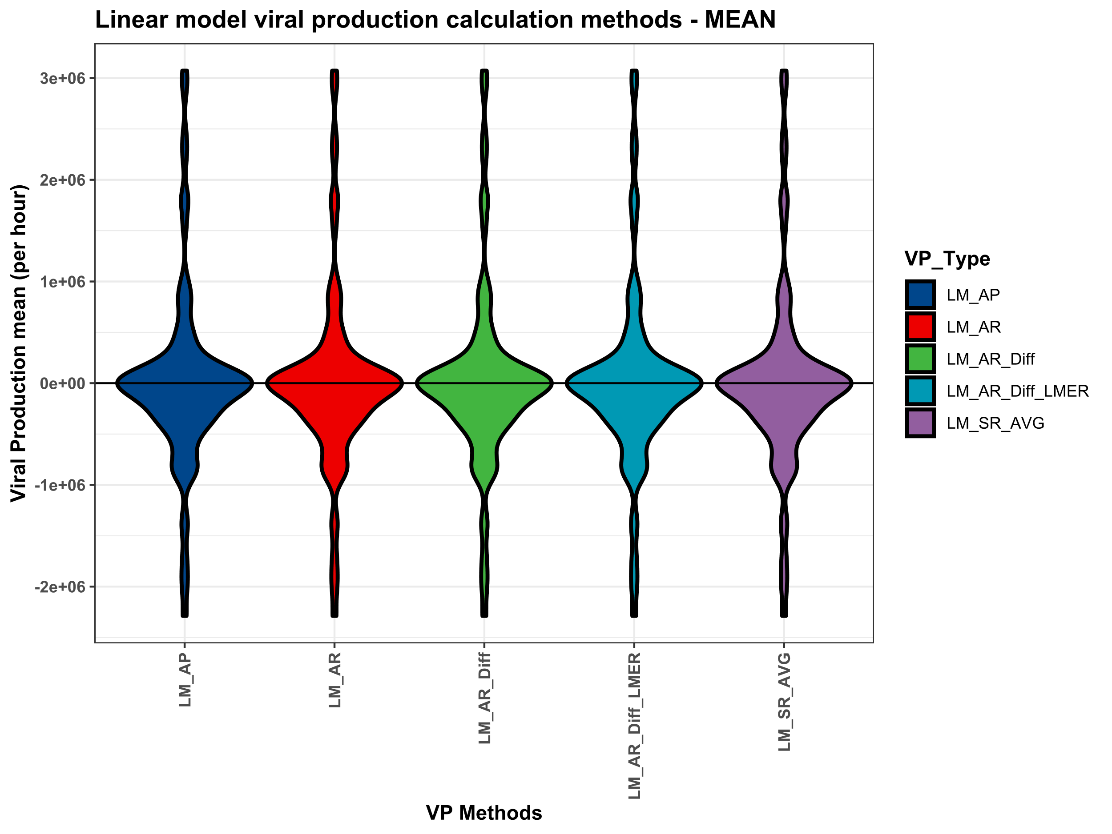
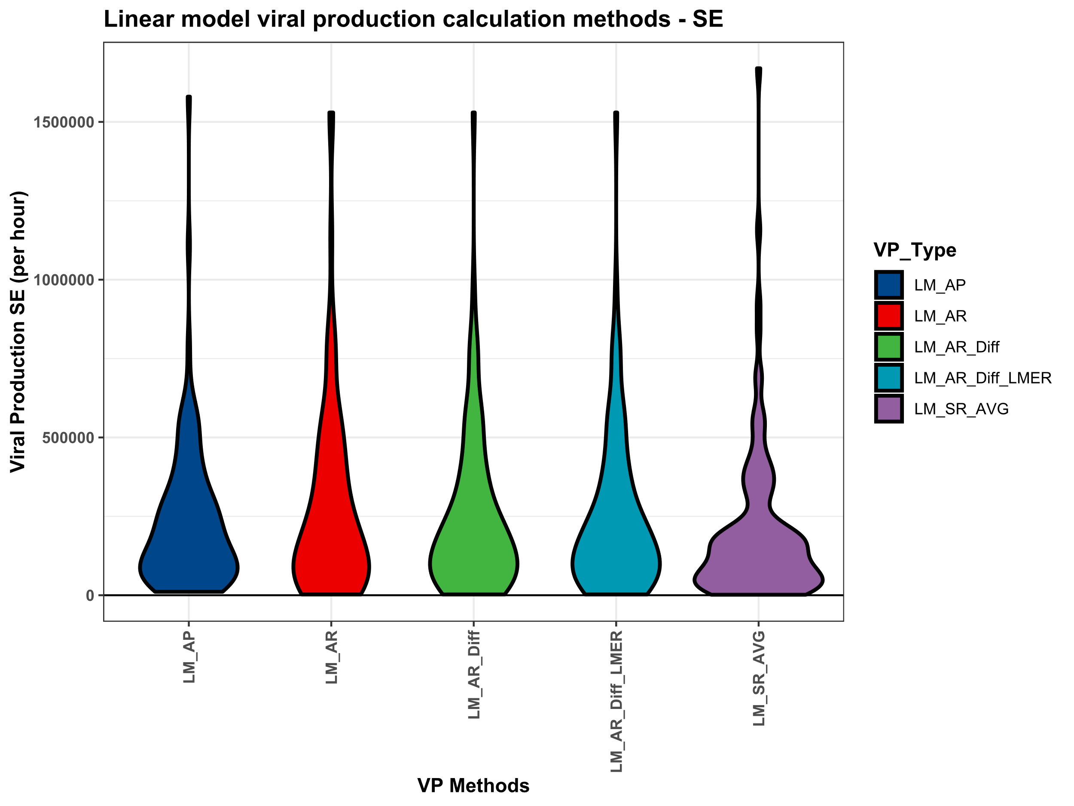
Total Viruses

Slide 8
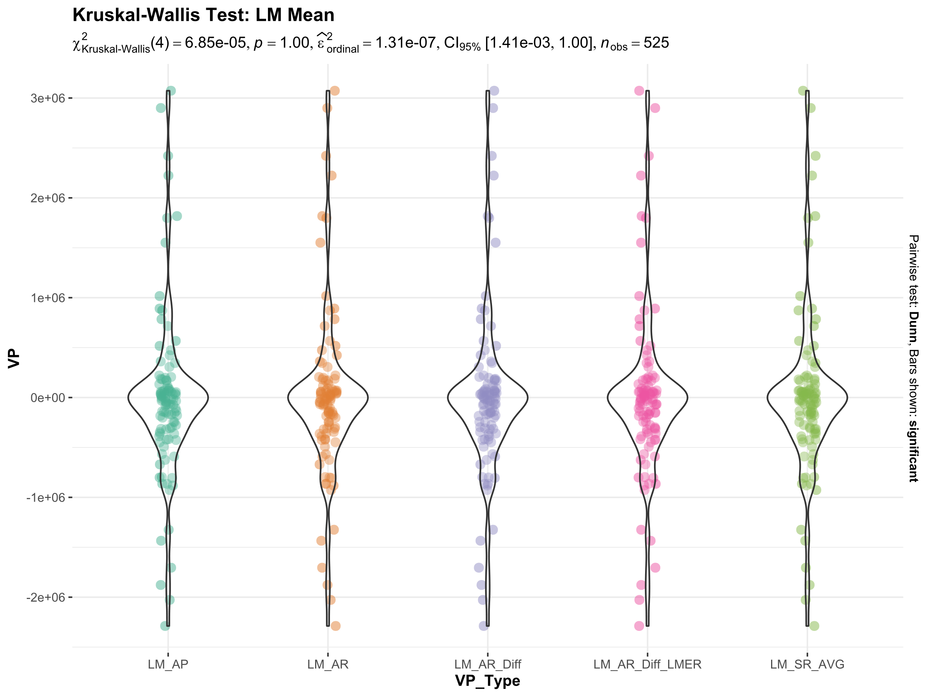
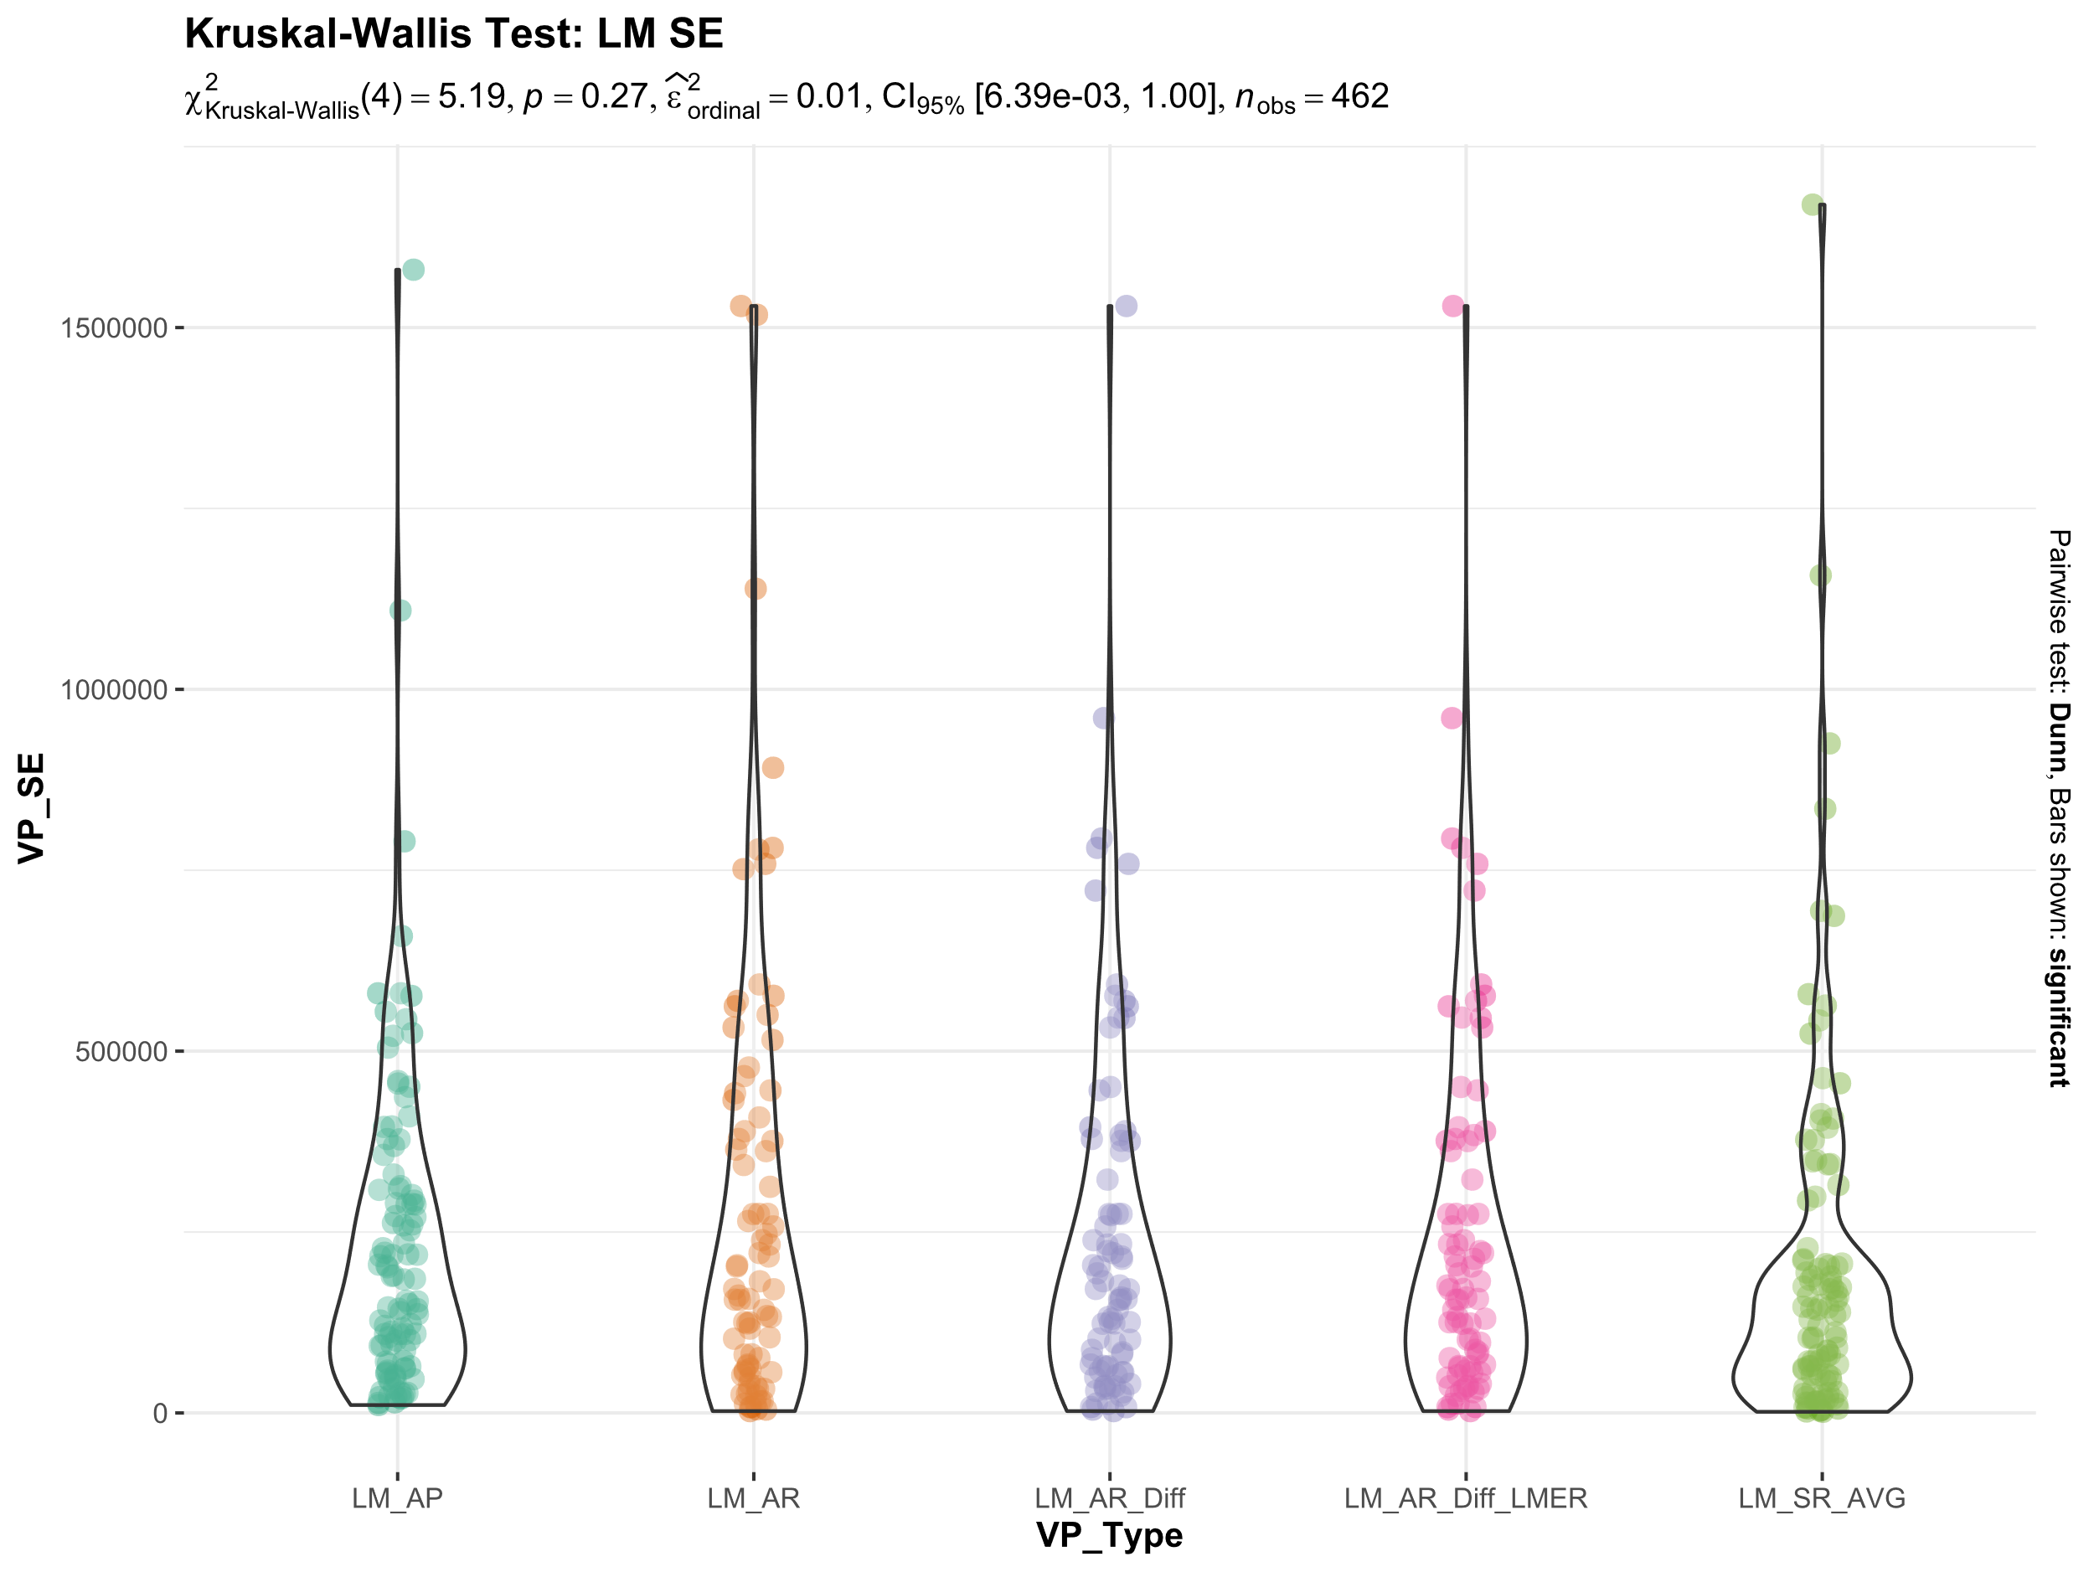
Total Viruses
No significant differences between the linear methods

Slide 9
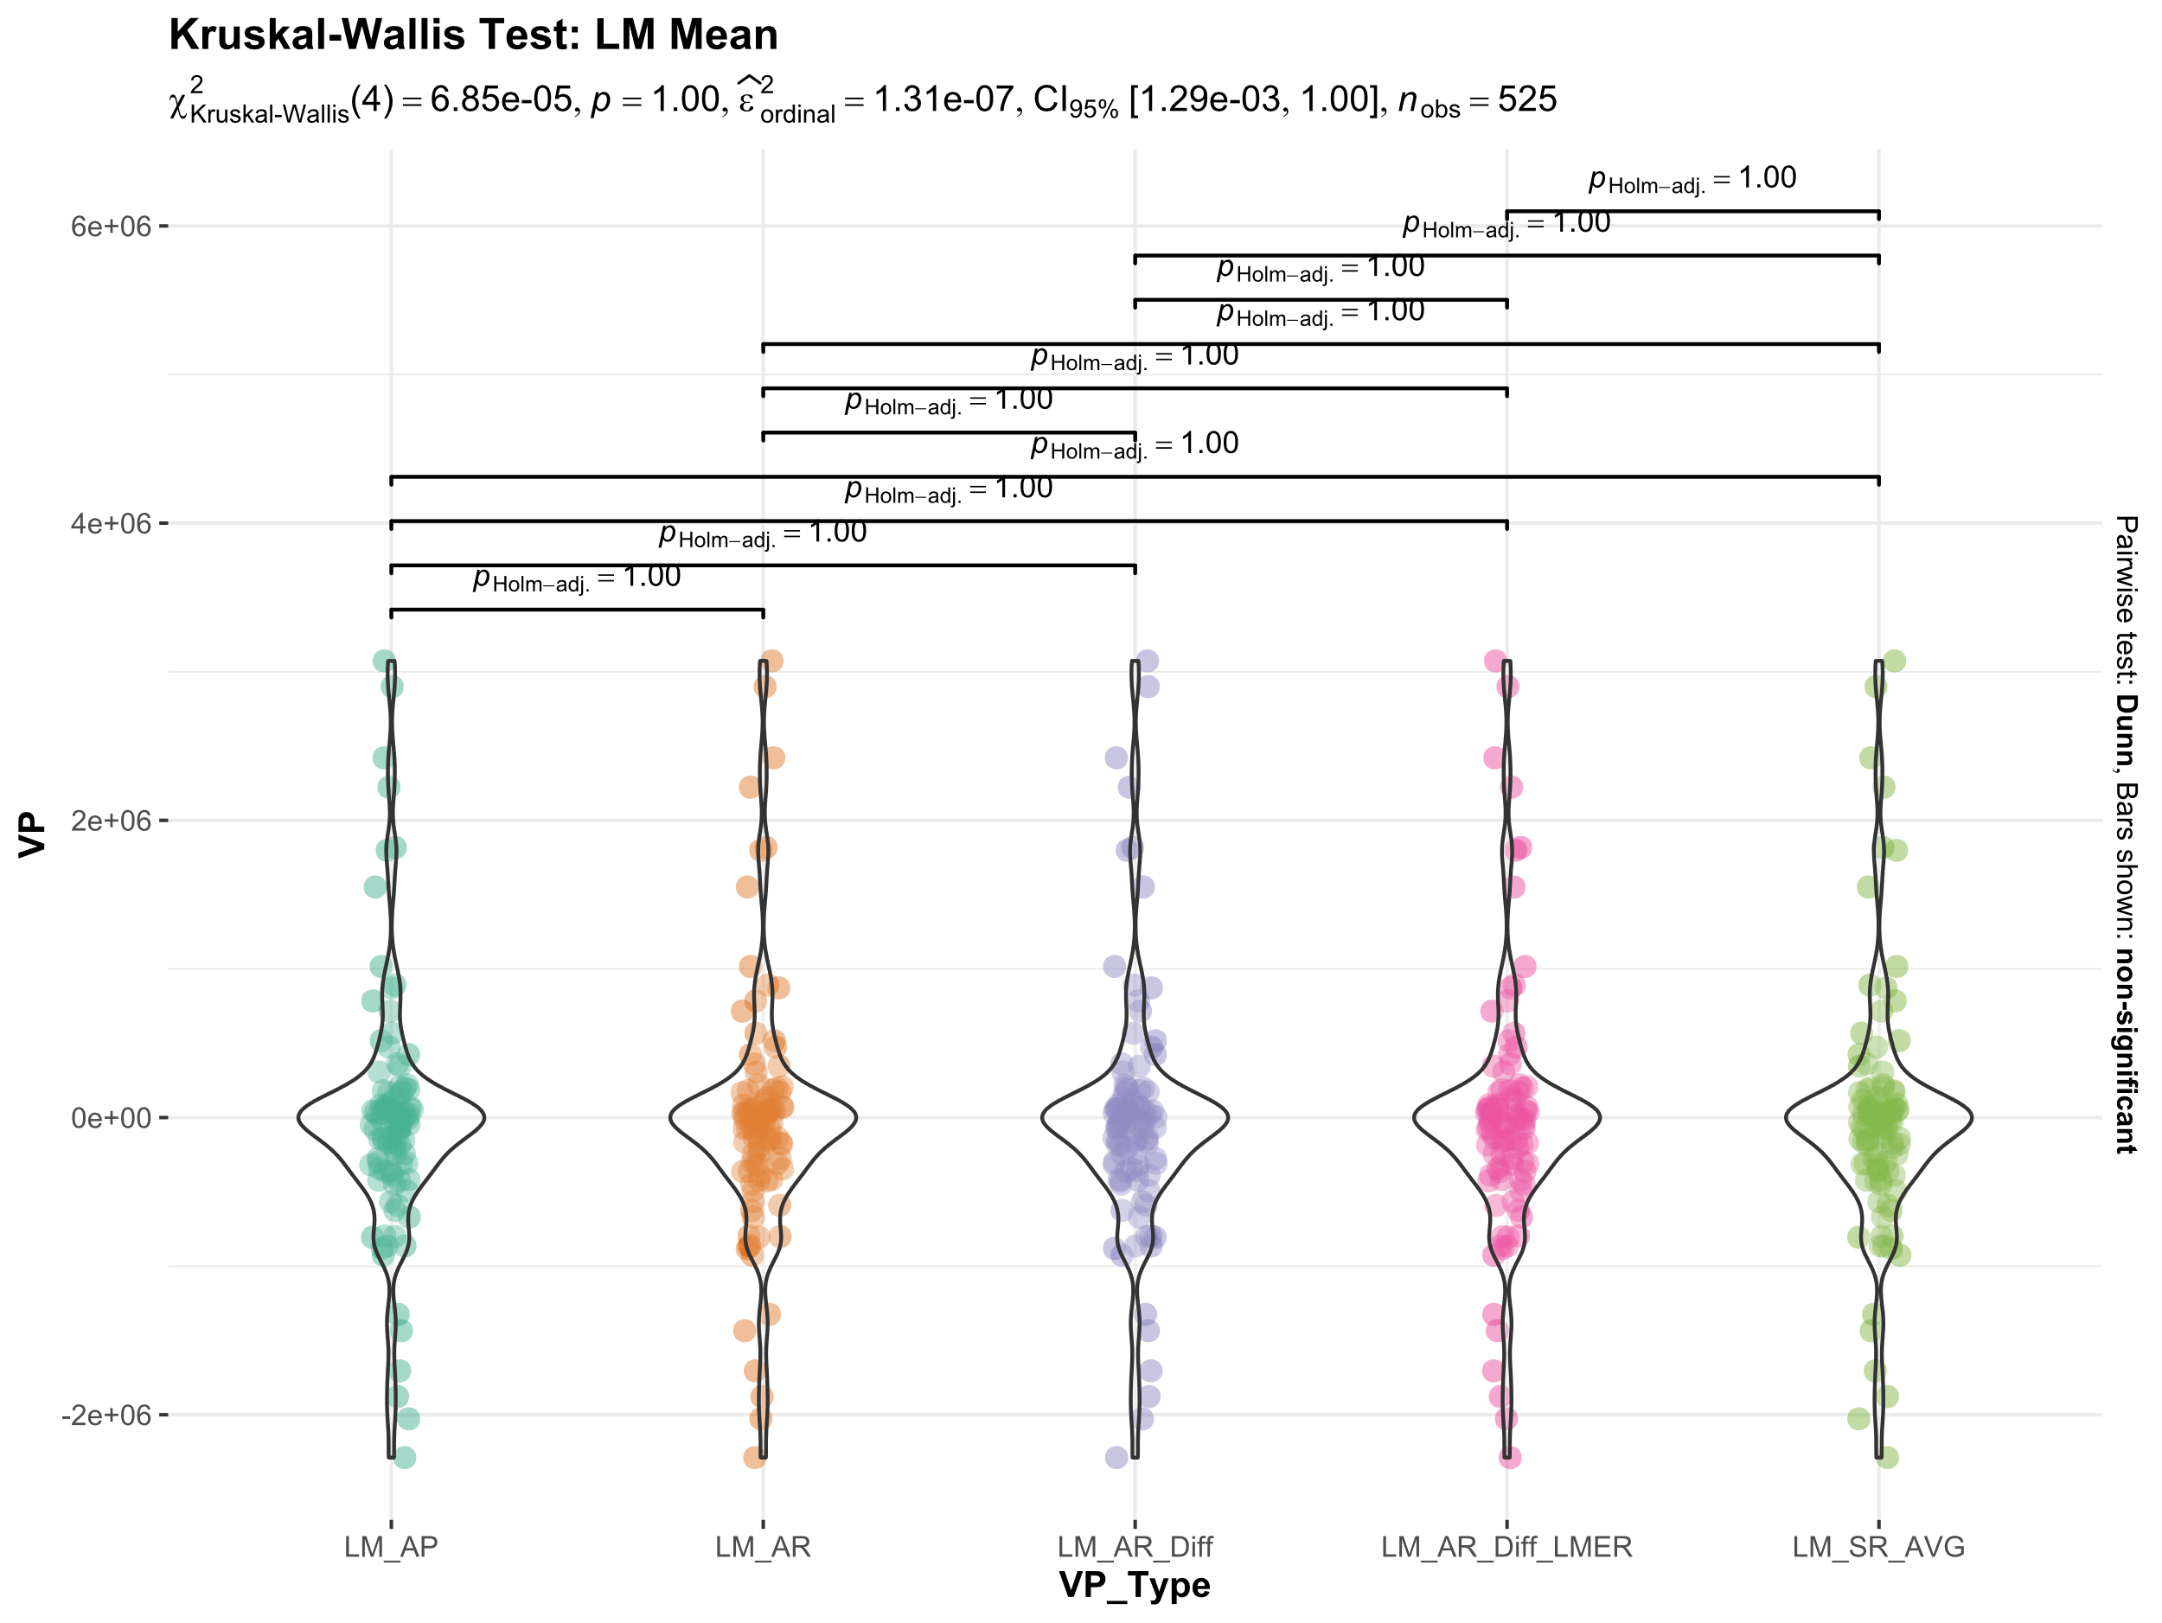

Slide 10
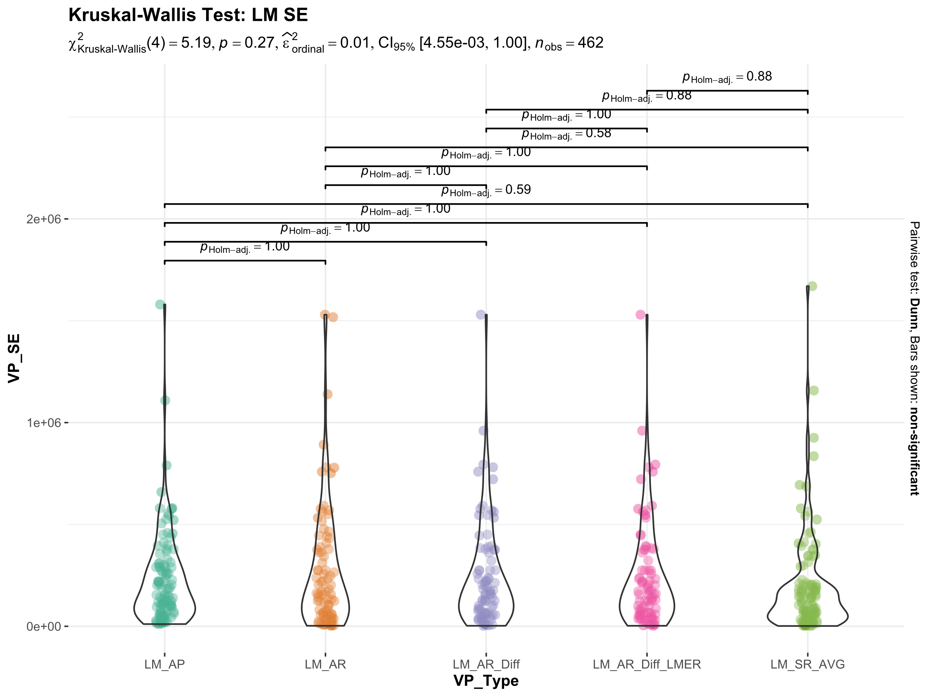

Slide 11
LM_SR_AVG: The standard error from each linear model is ignored.
LM_AR: SE is calculated per timepoint. Although only the mean is used to calculate the slopes
LM_AR_Diff: Similar to LM_AR. Diff is calculated first
LM_AR_Diff: Similar to LM_AR. Diff is calculated first using LMER

Slide 12
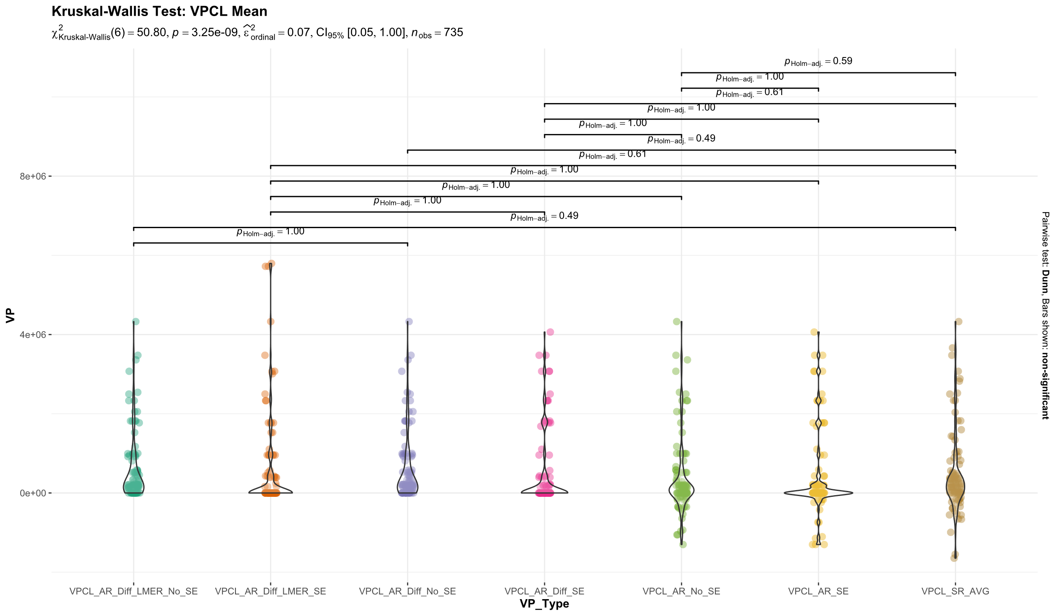

Slide 13
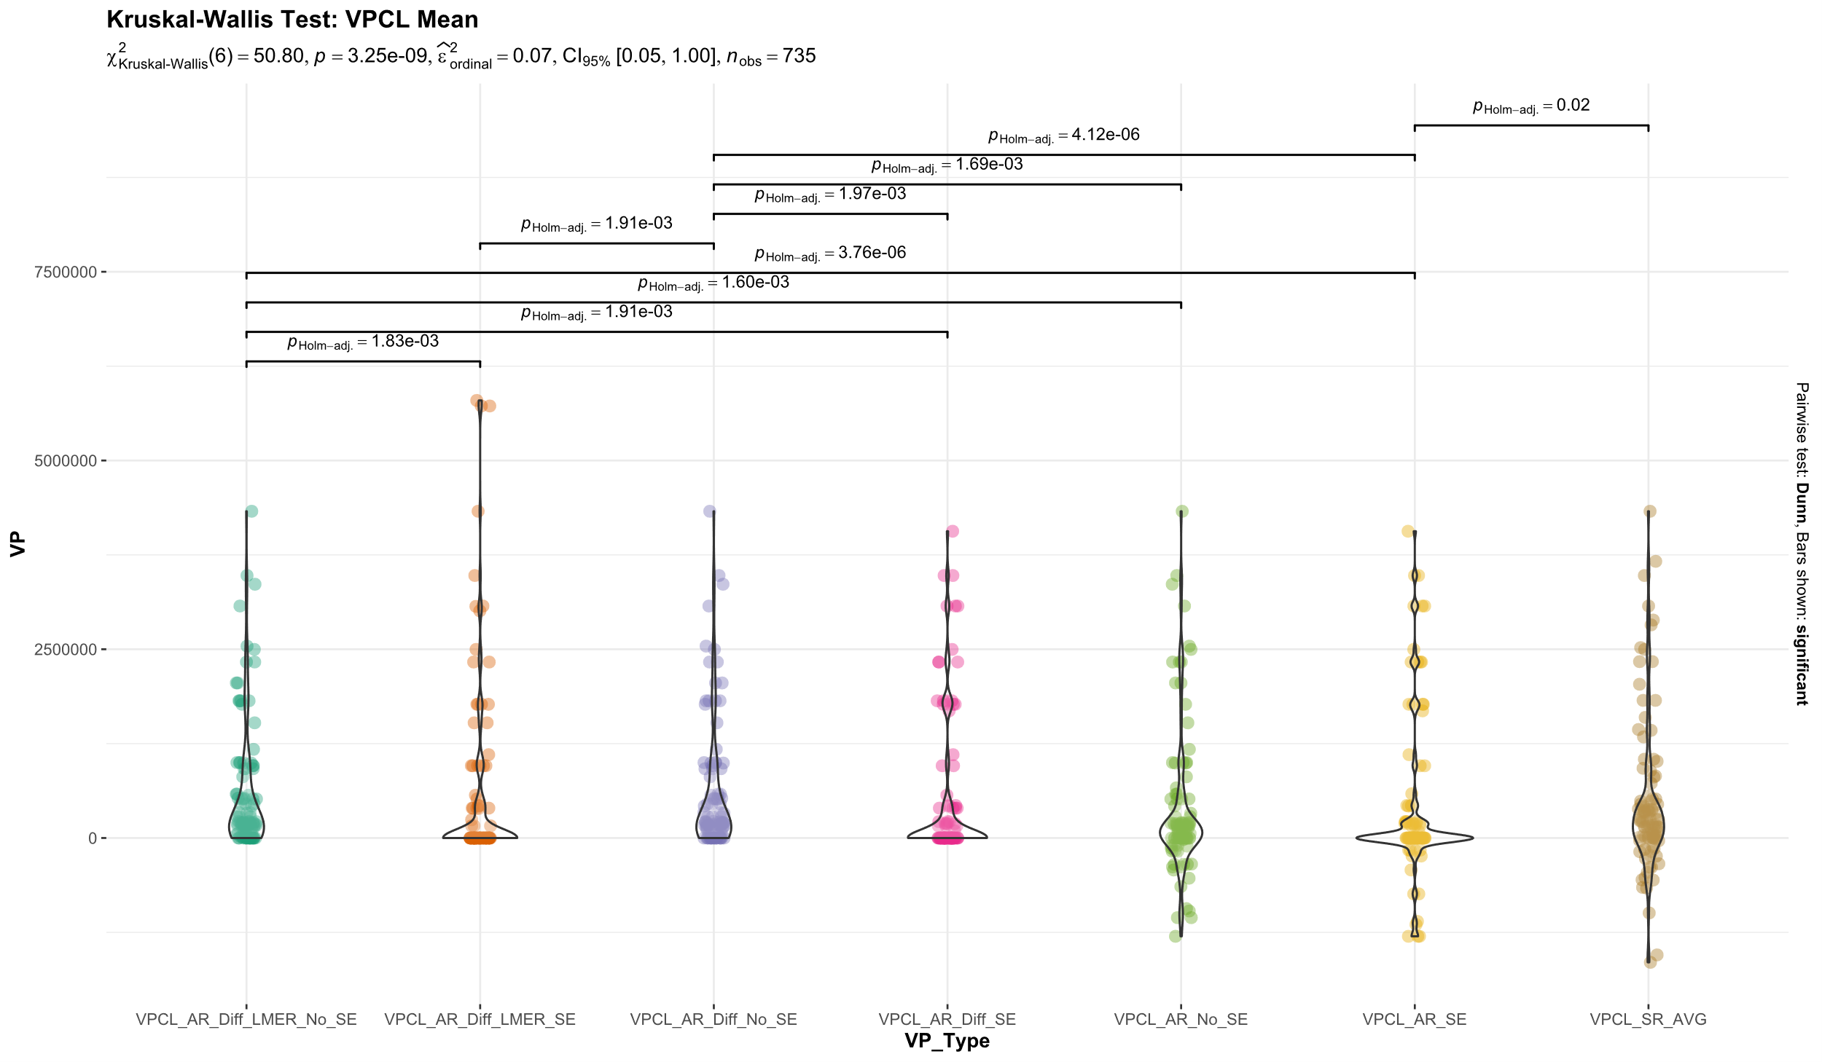

Slide 14
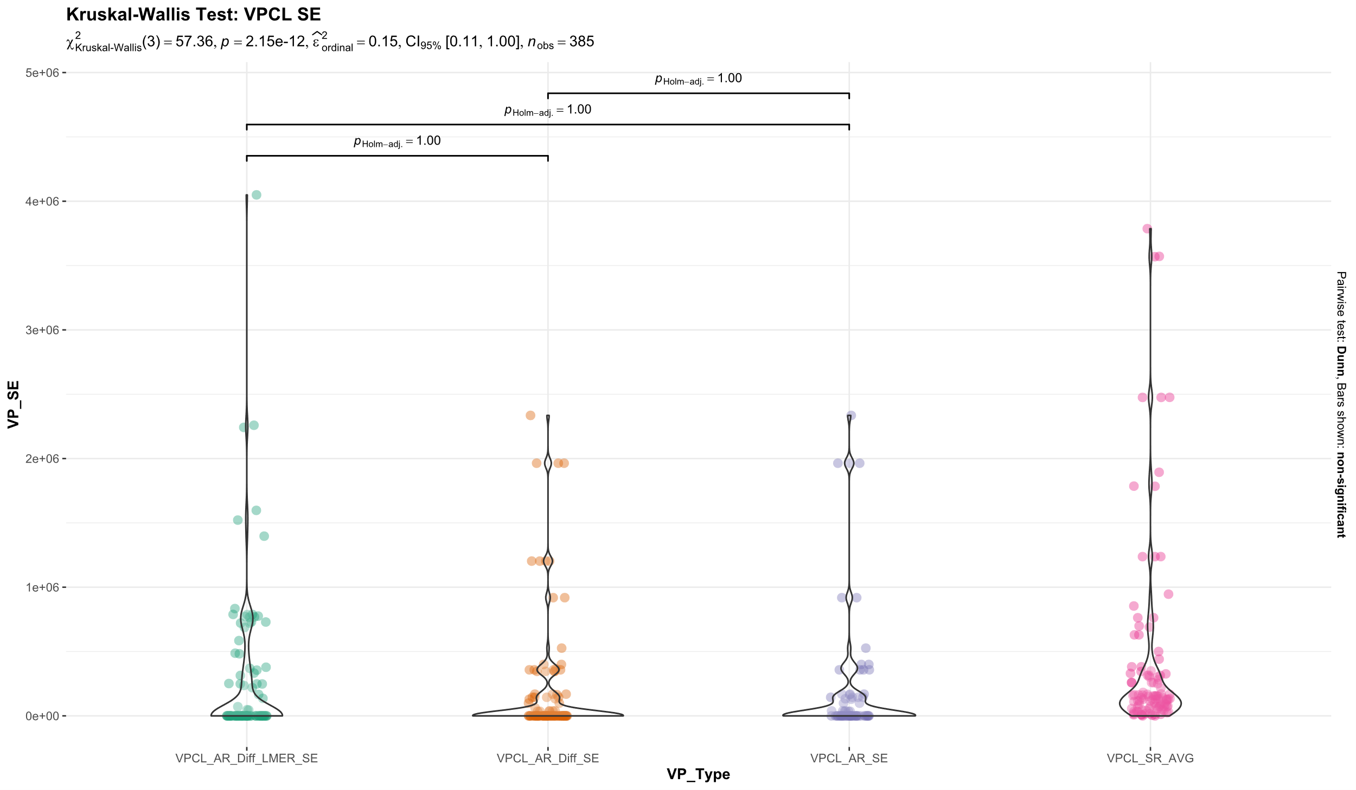

Slide 15
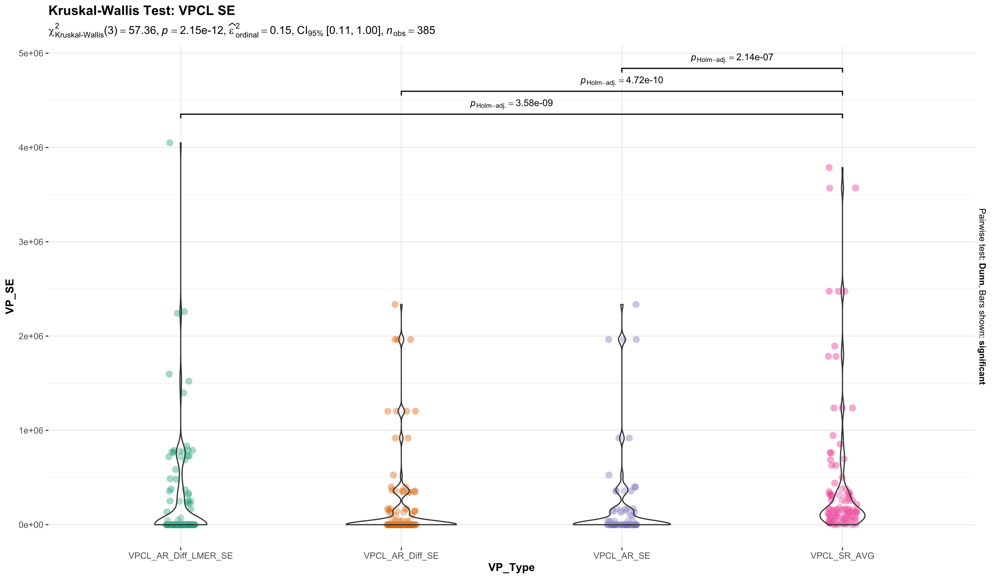

Slide 16
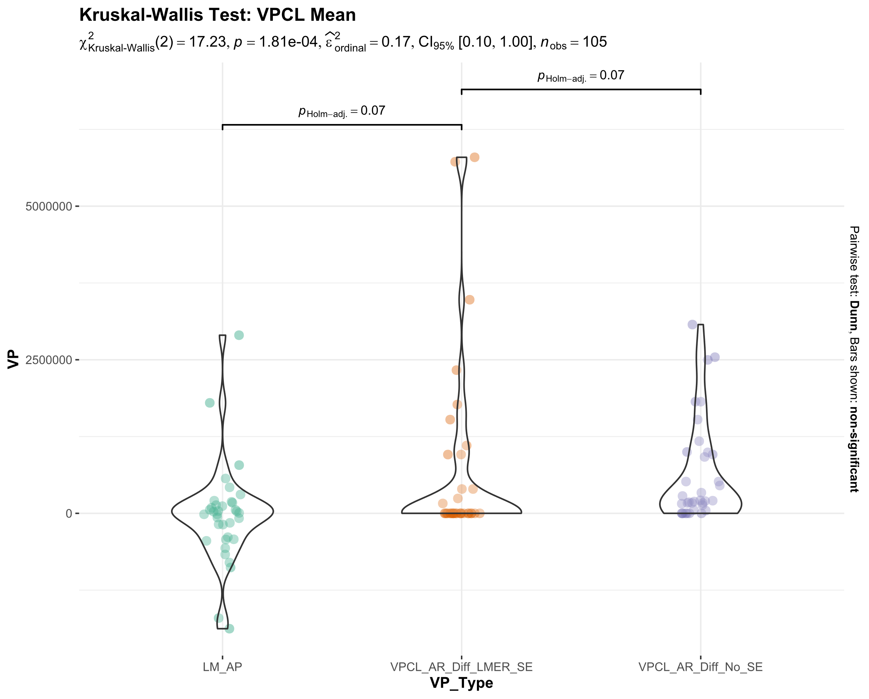

Slide 17
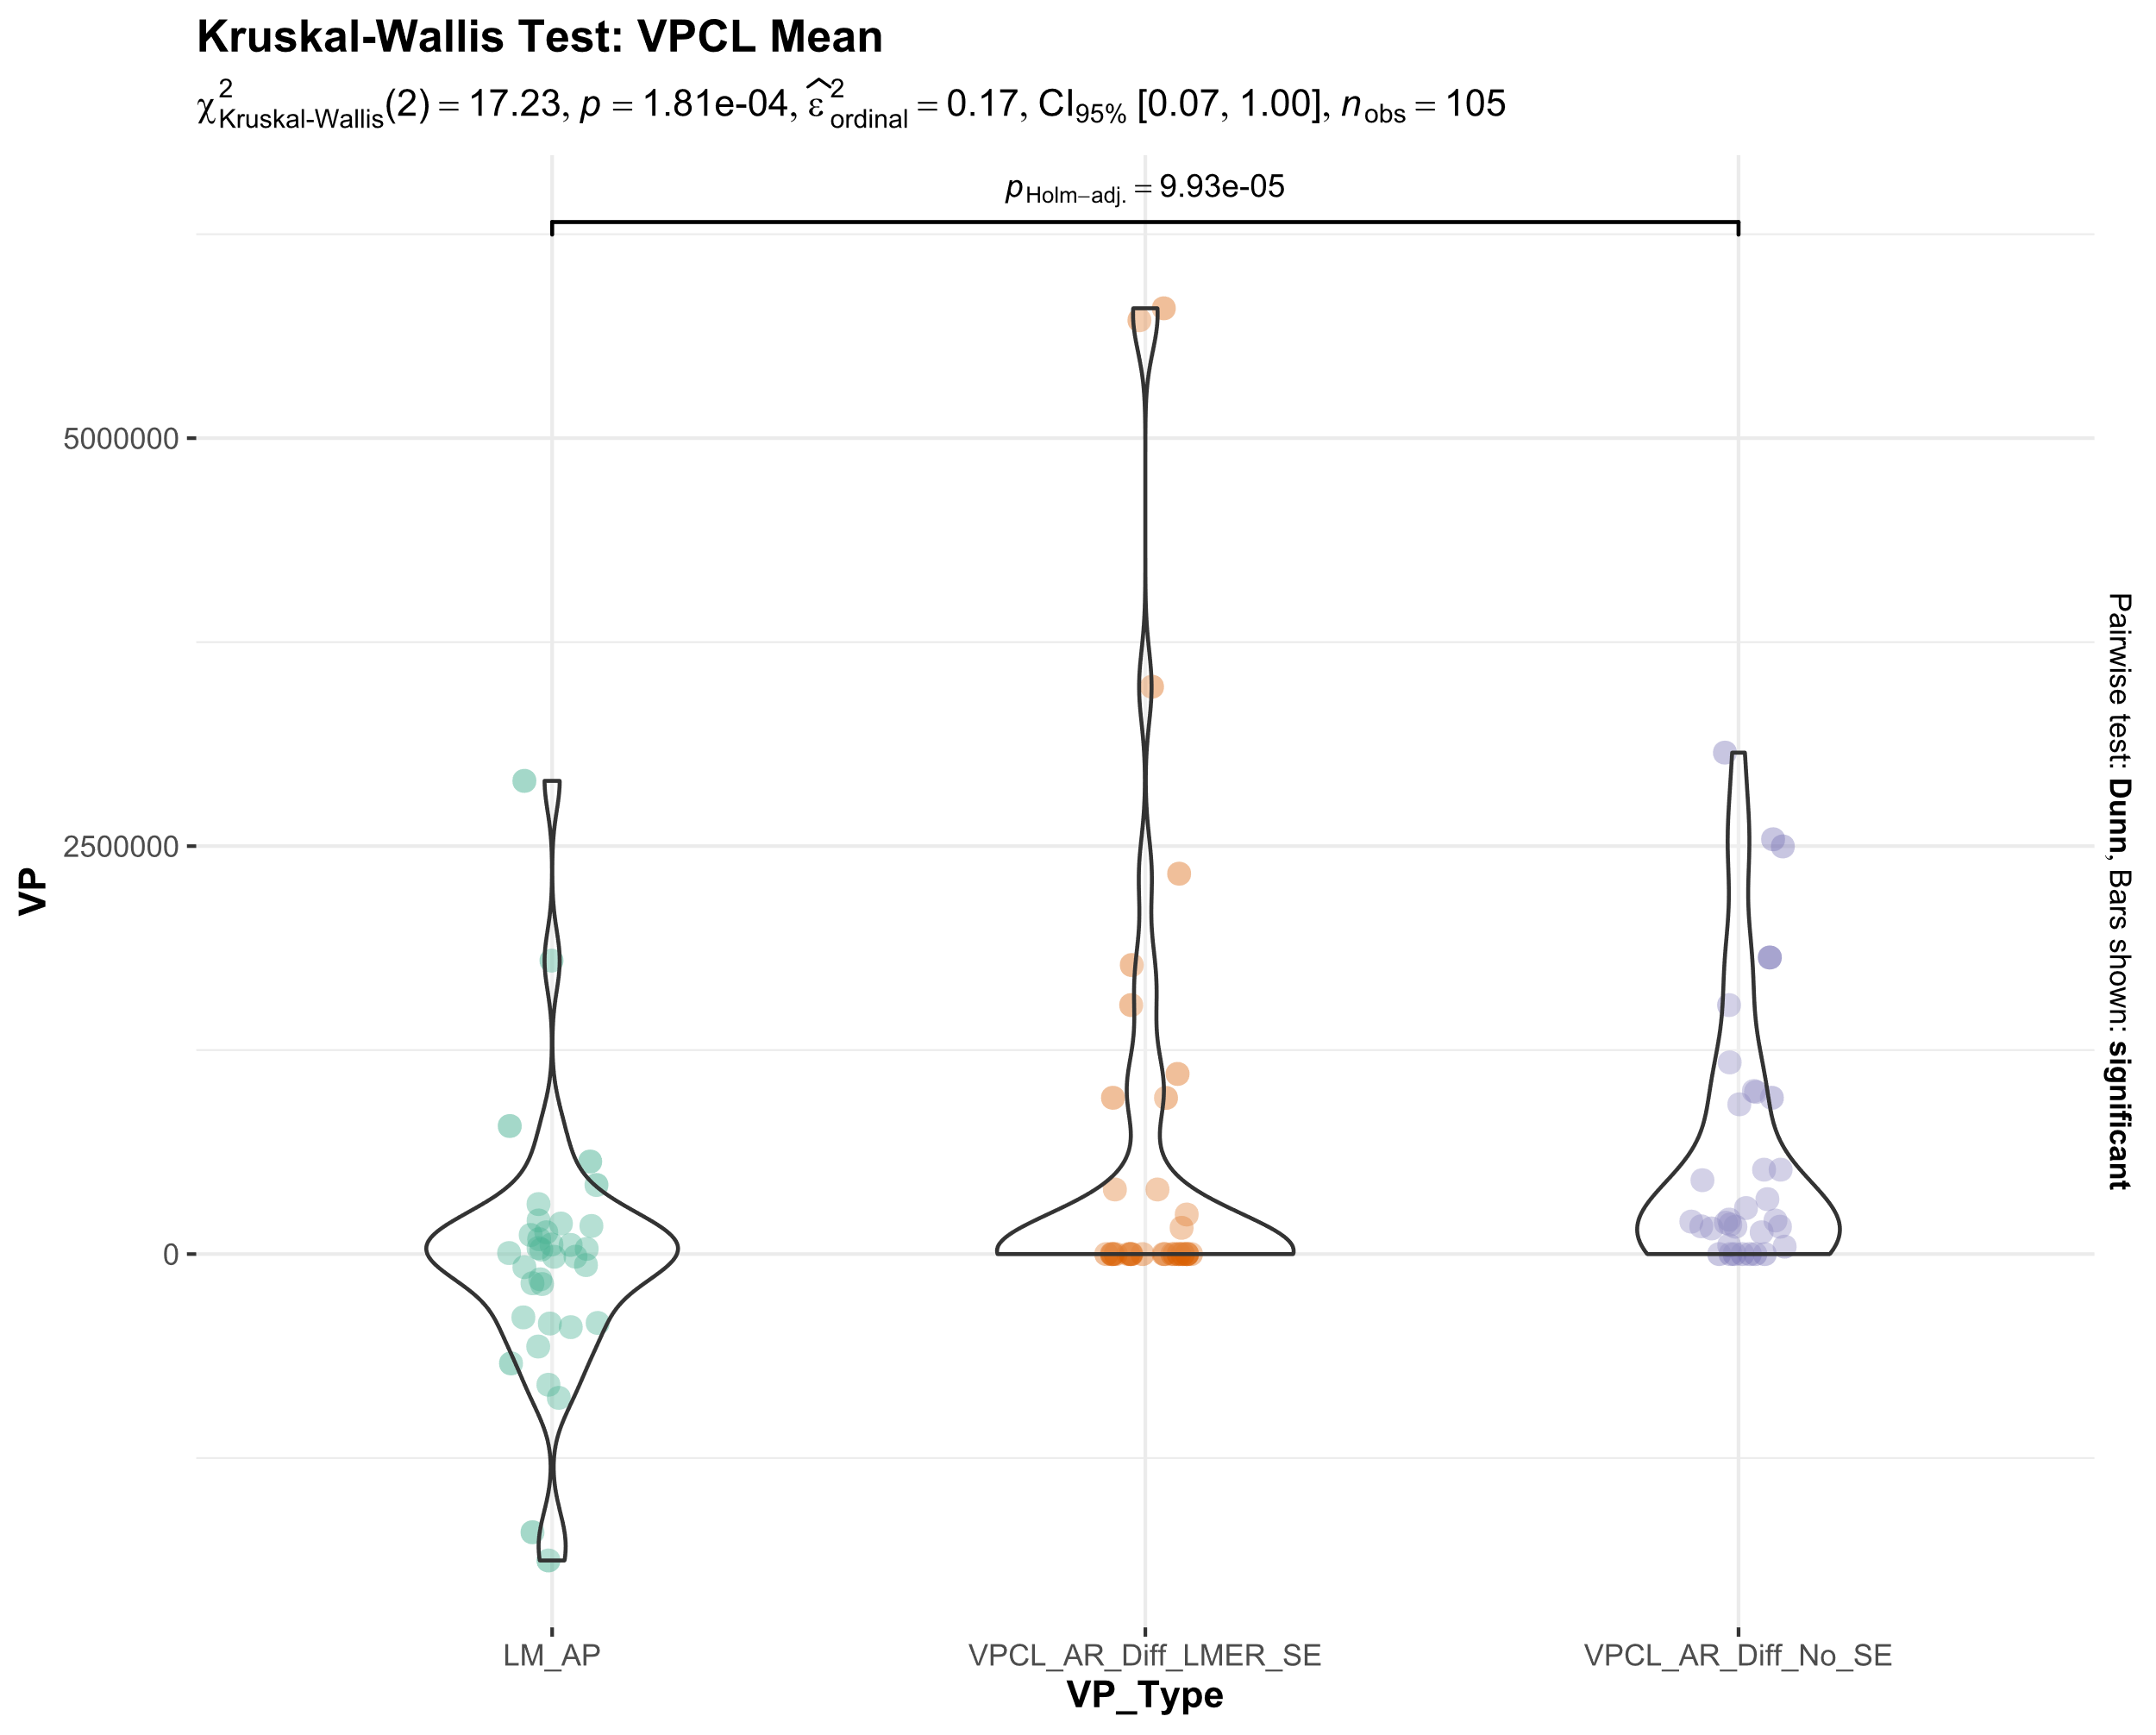
Transform the data with abs min +1

Slide 18
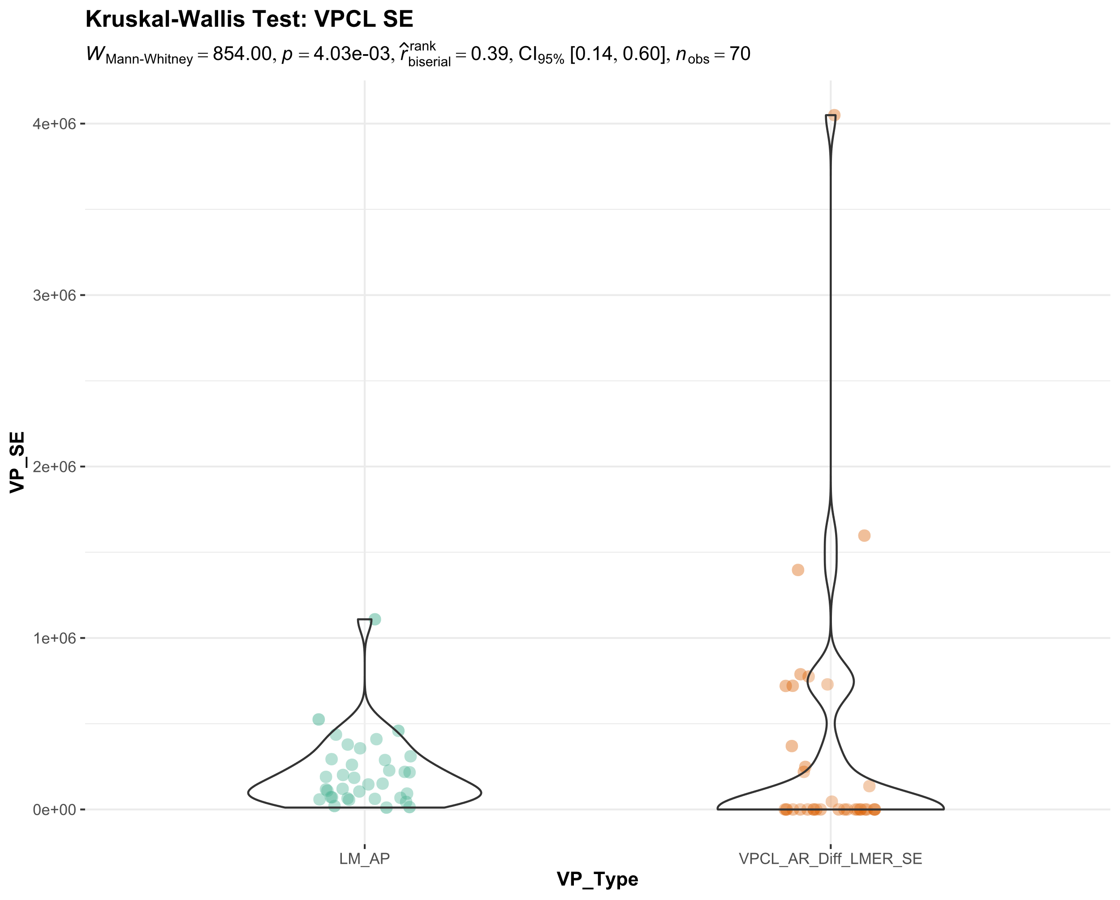

Slide 19
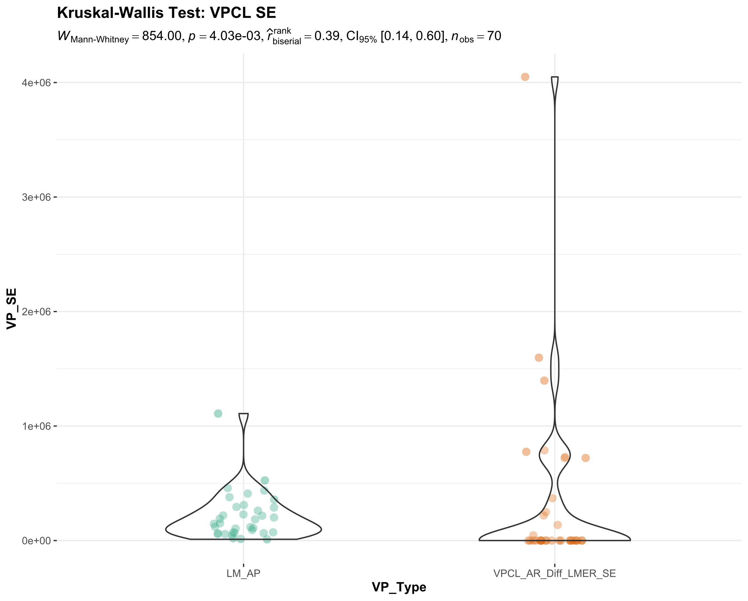

Slide 20
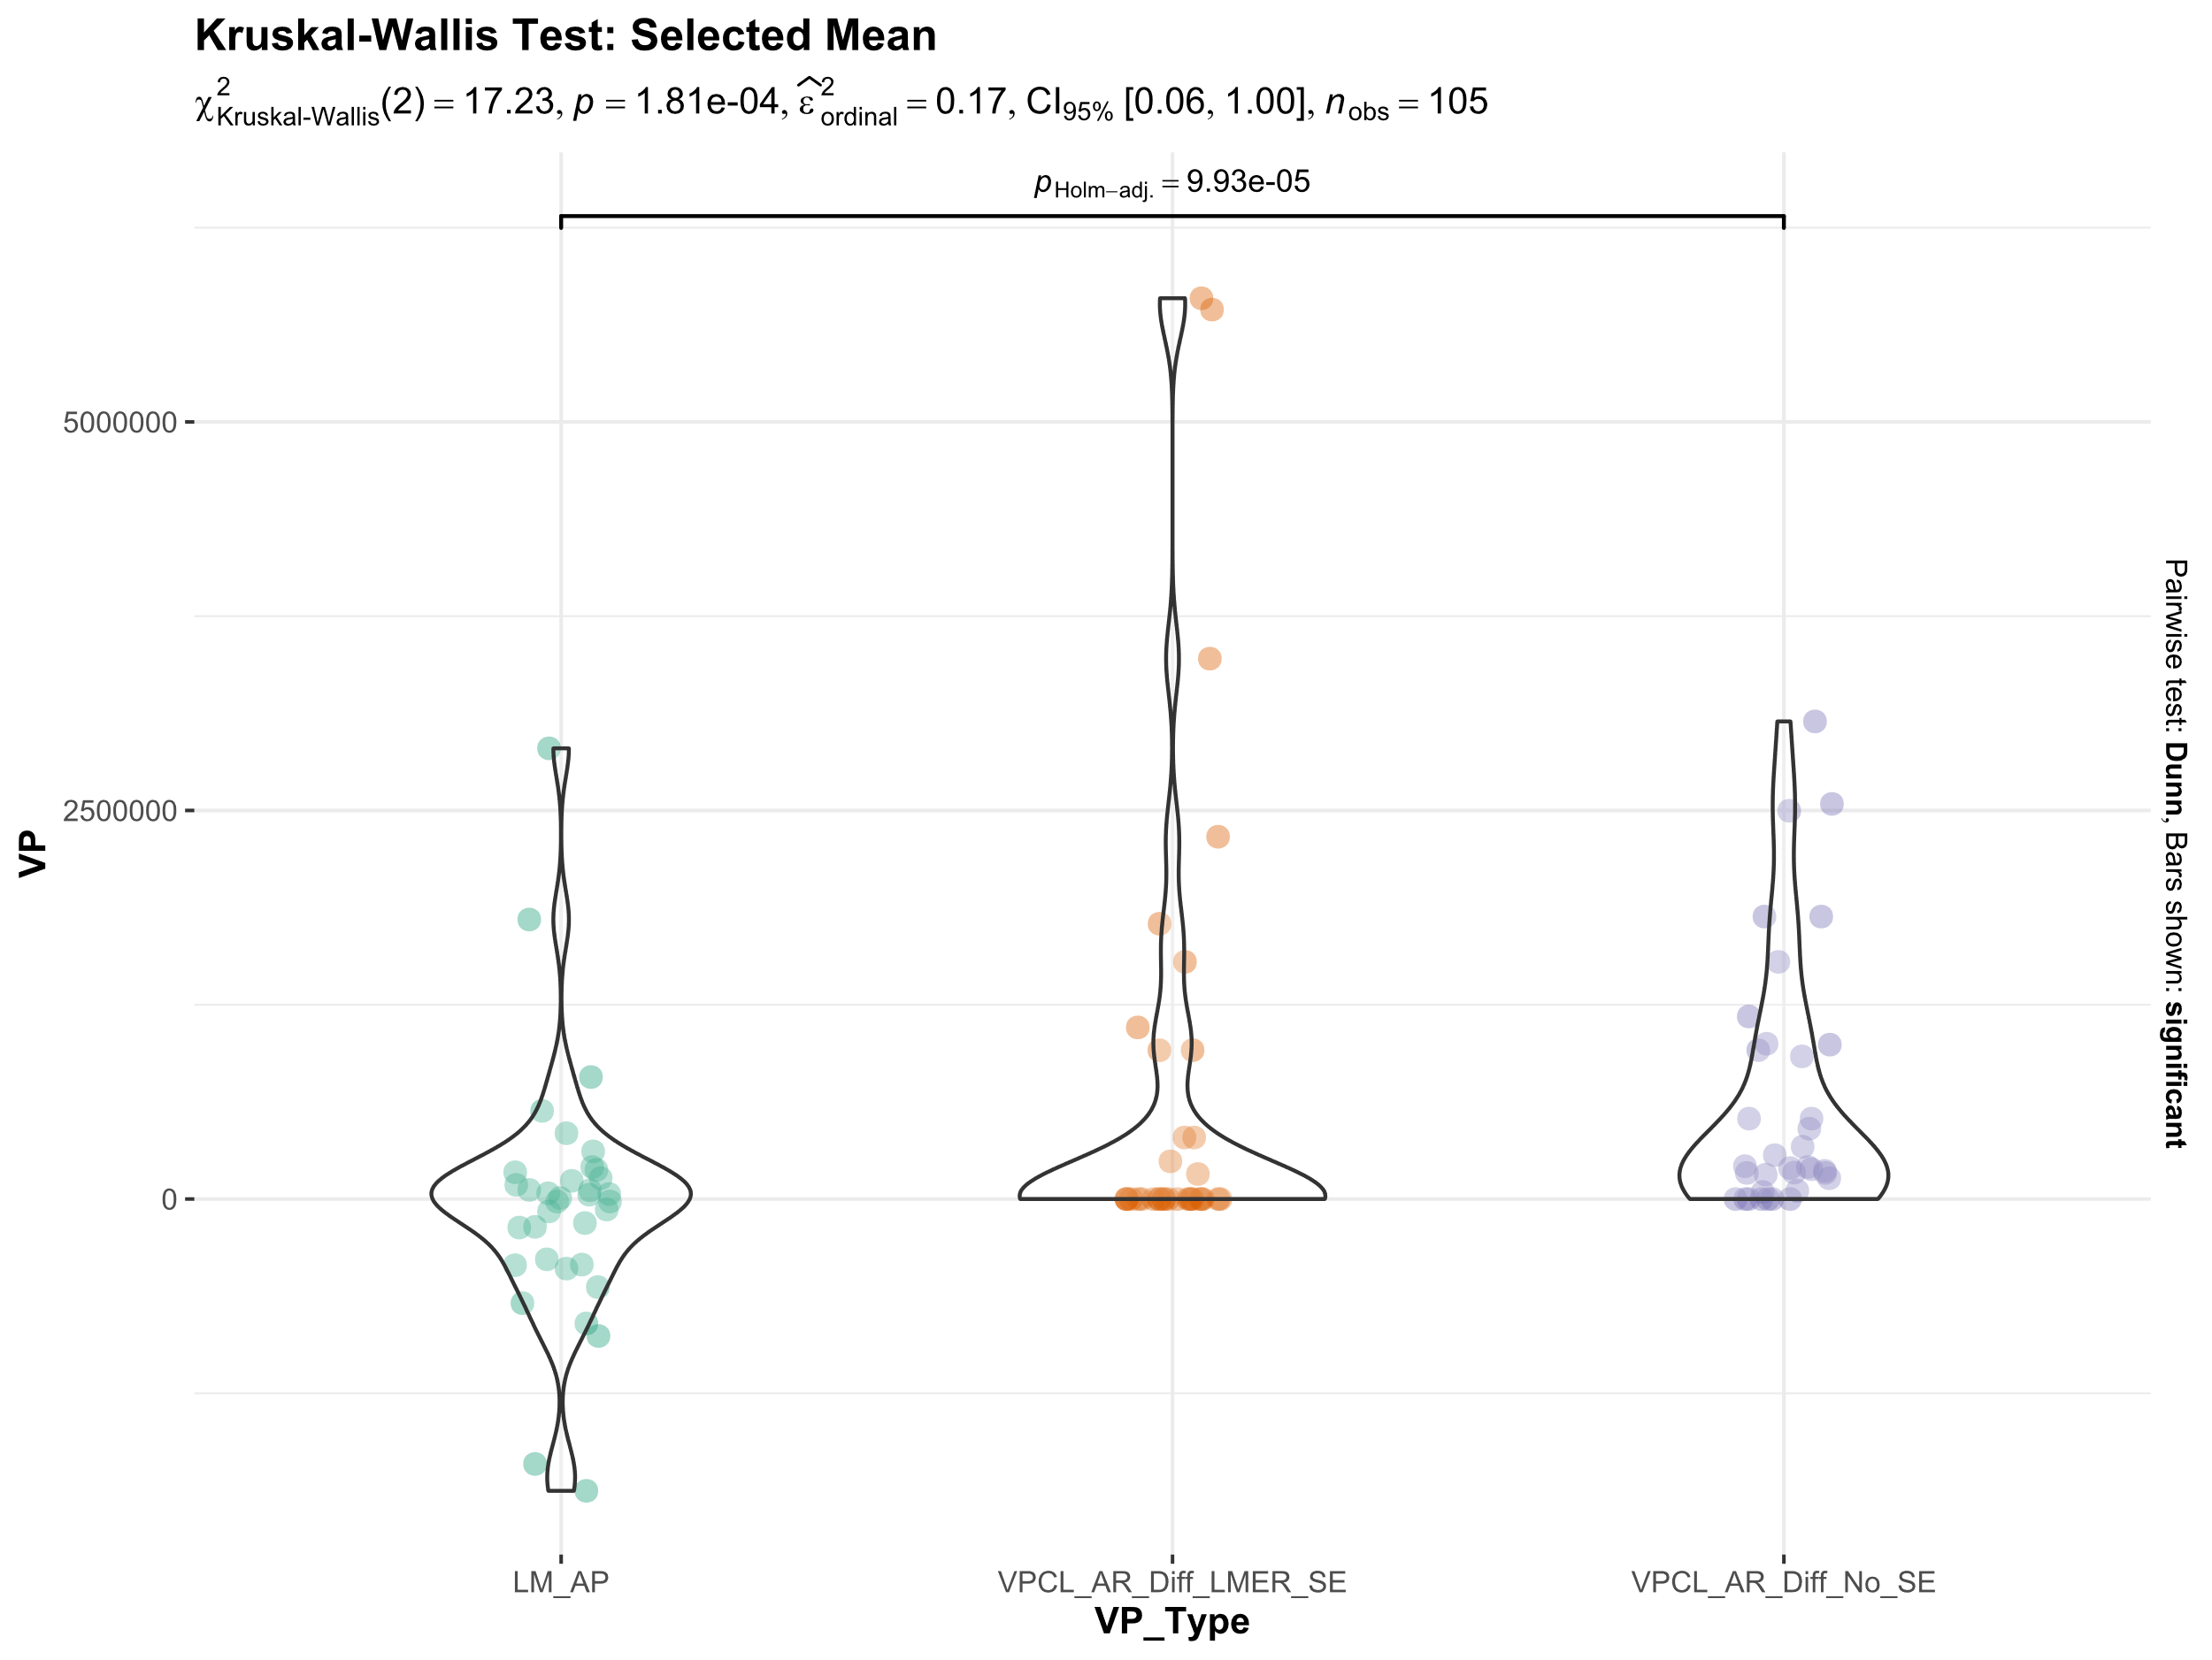
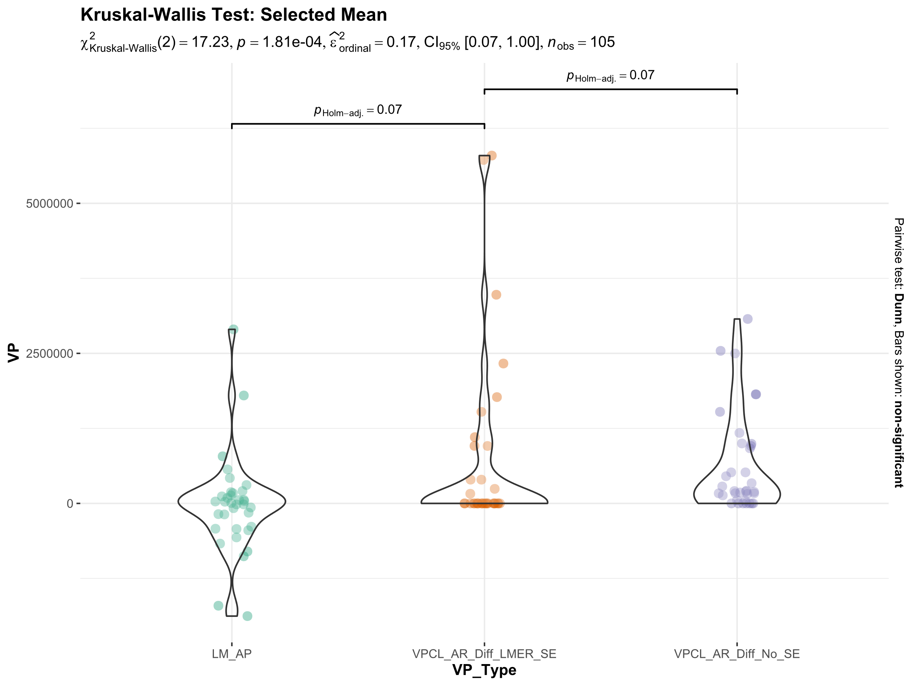

Slide 21
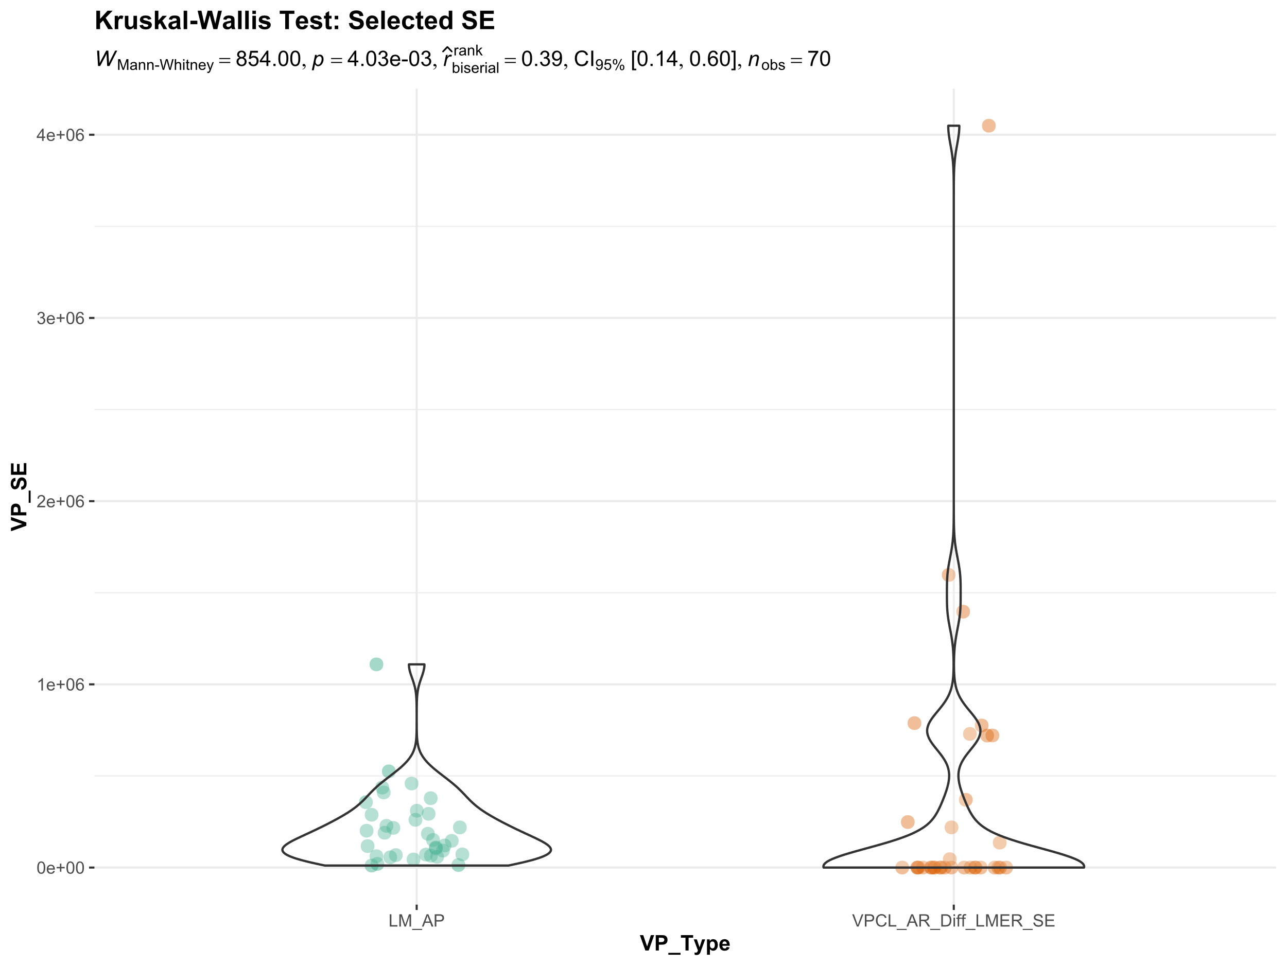
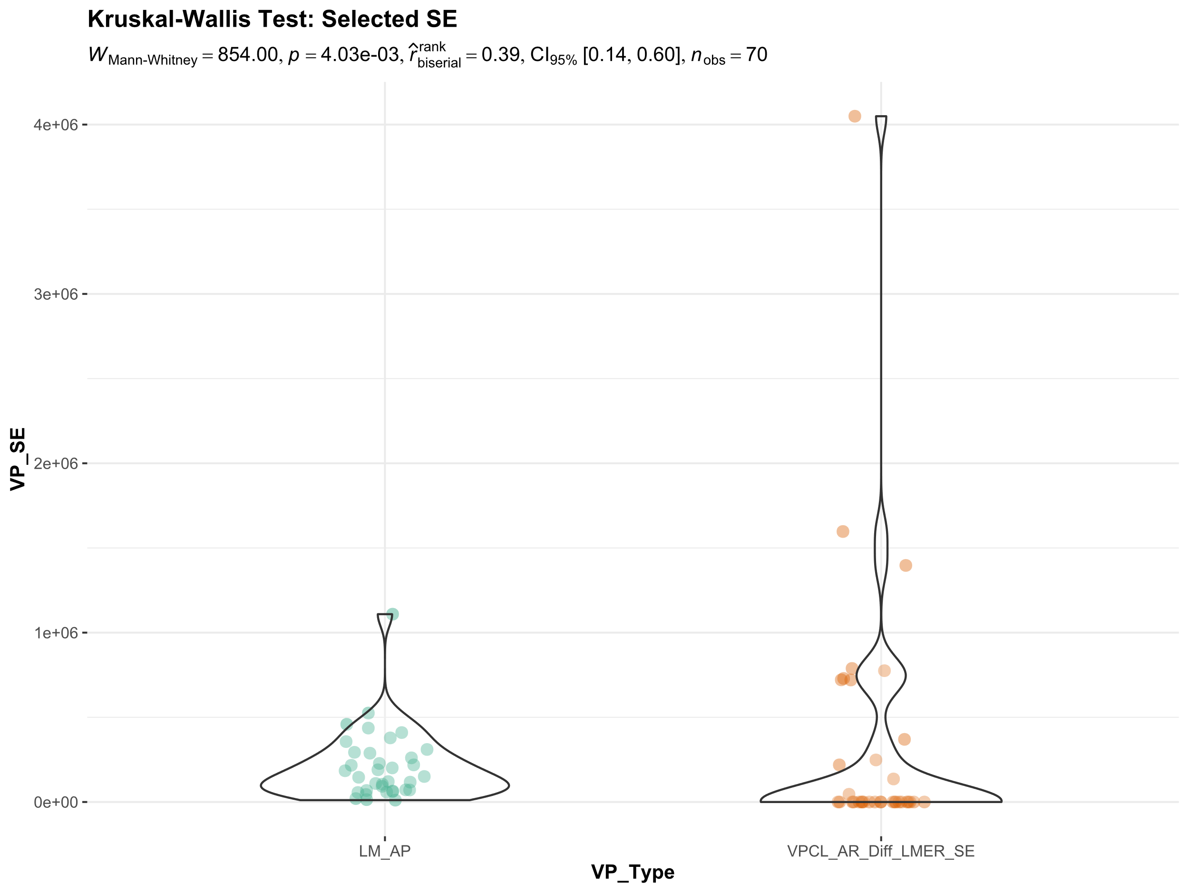

Slide 22
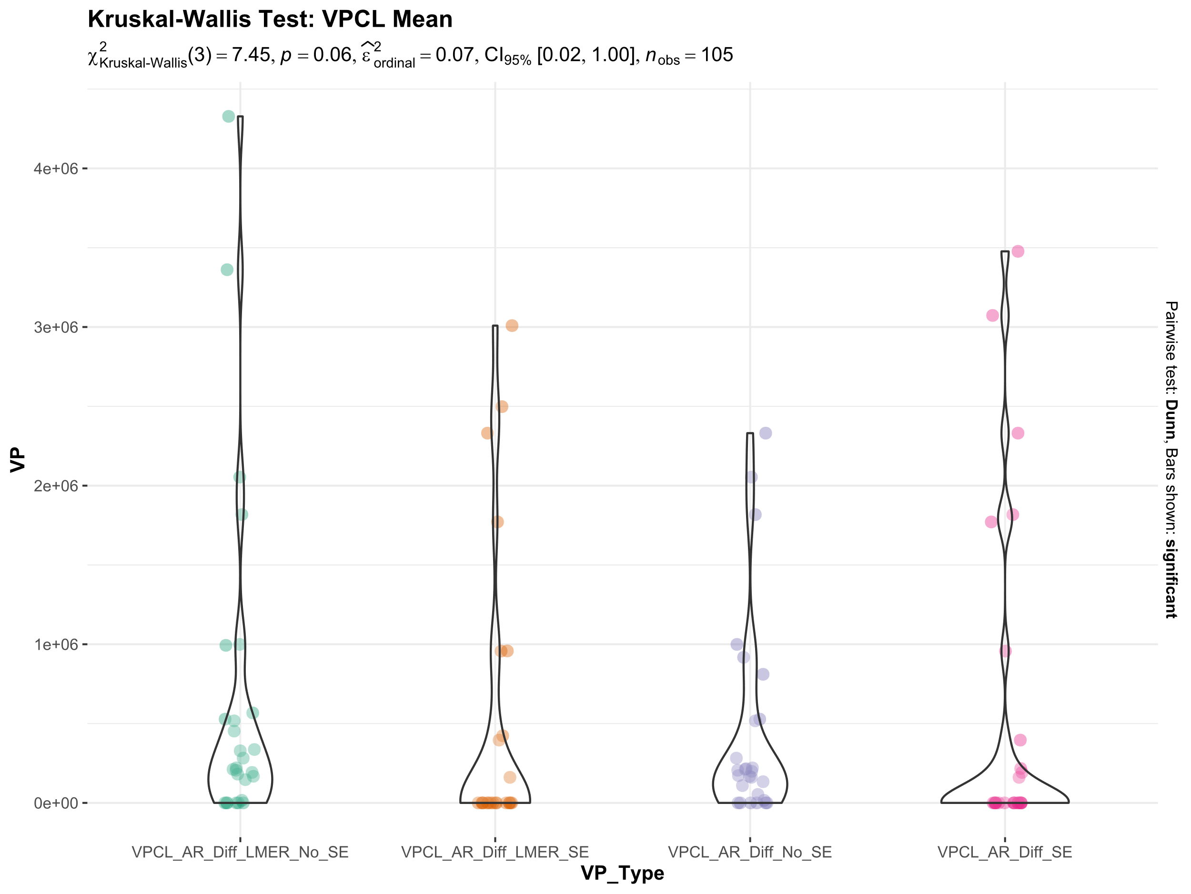
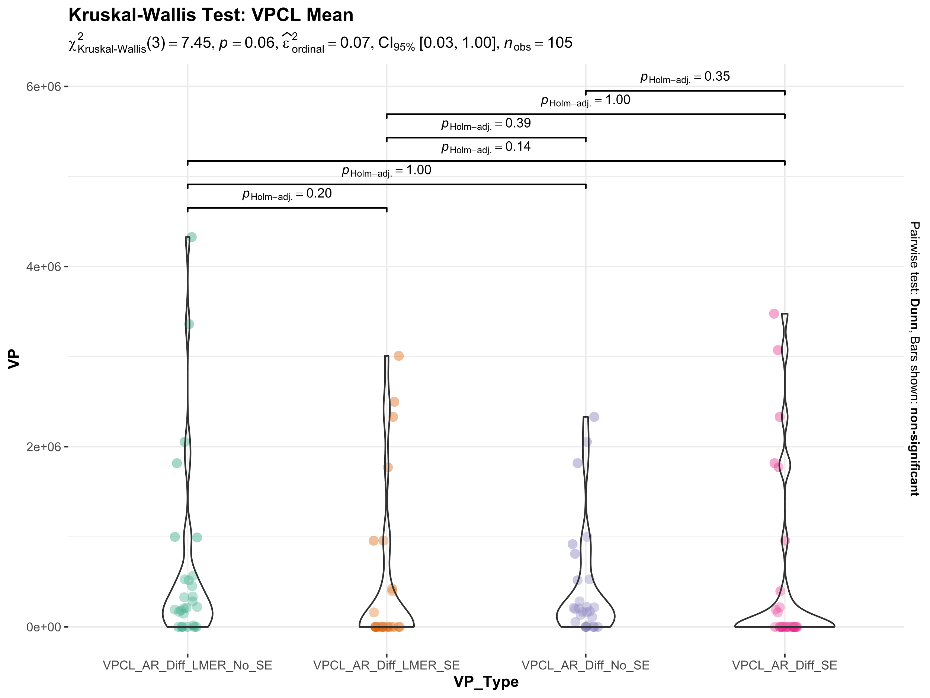

Slide 23
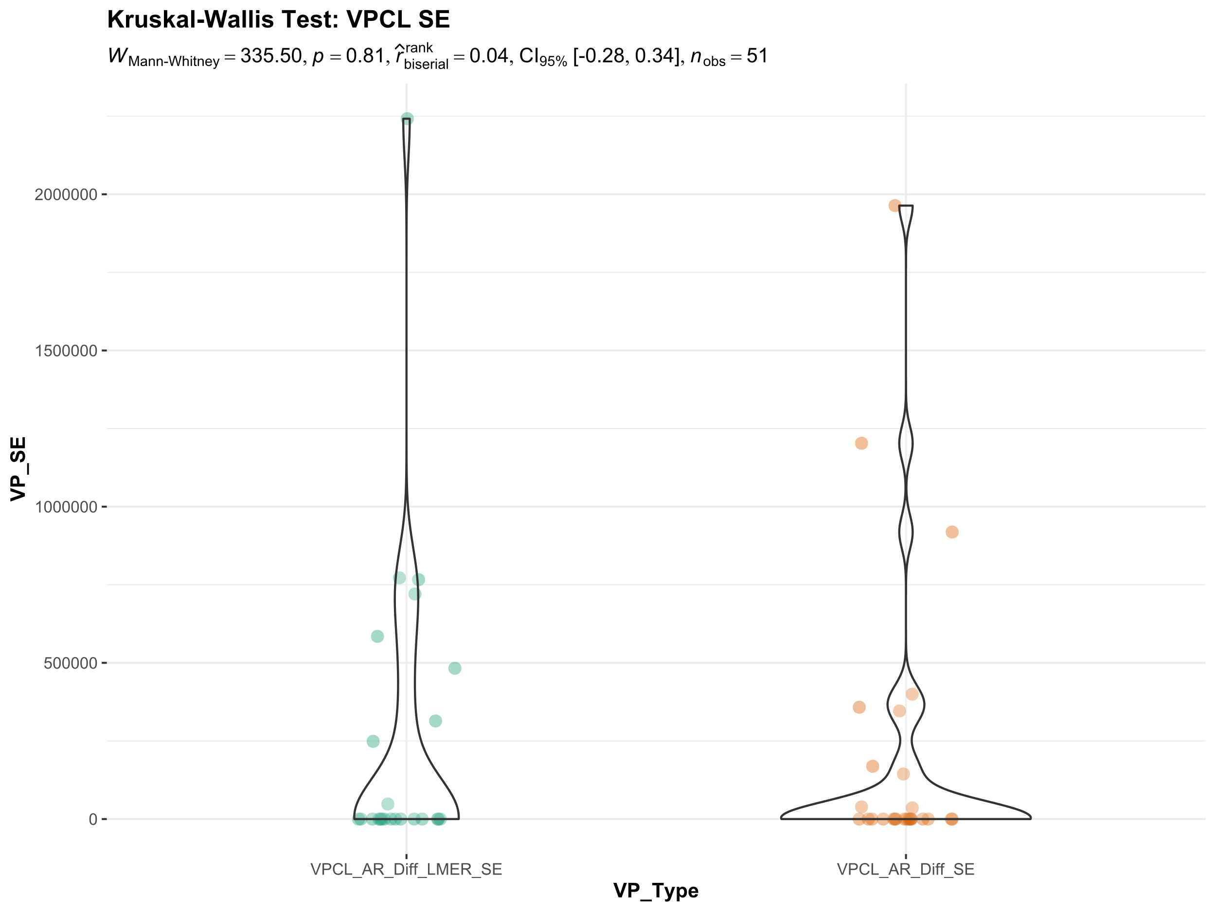
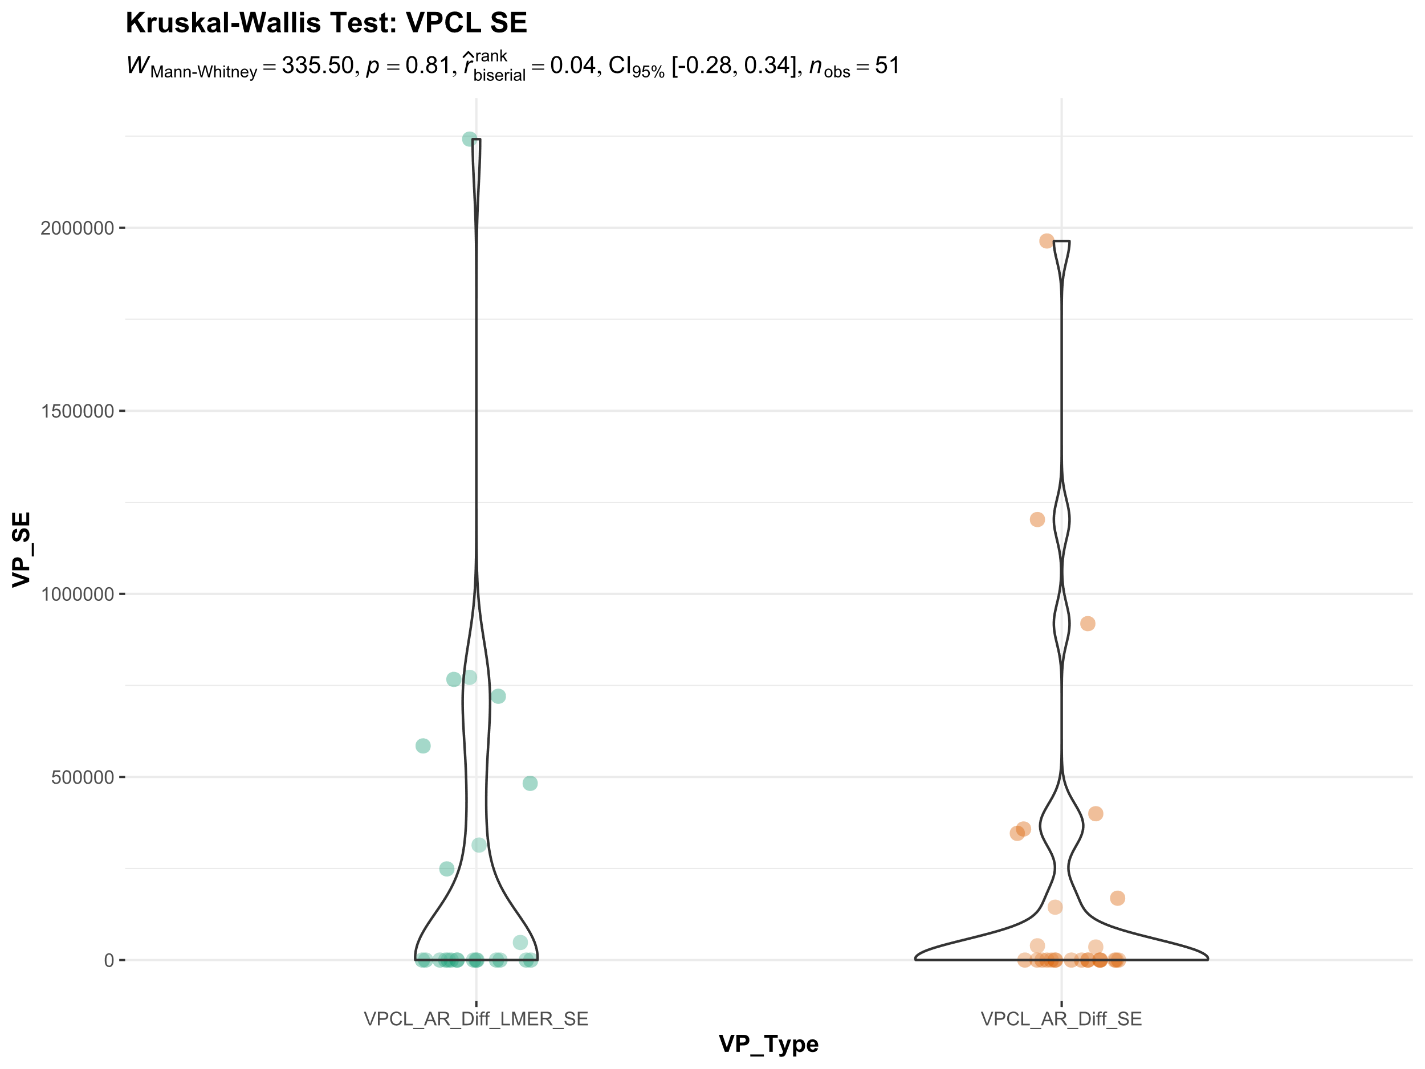

Slide 24
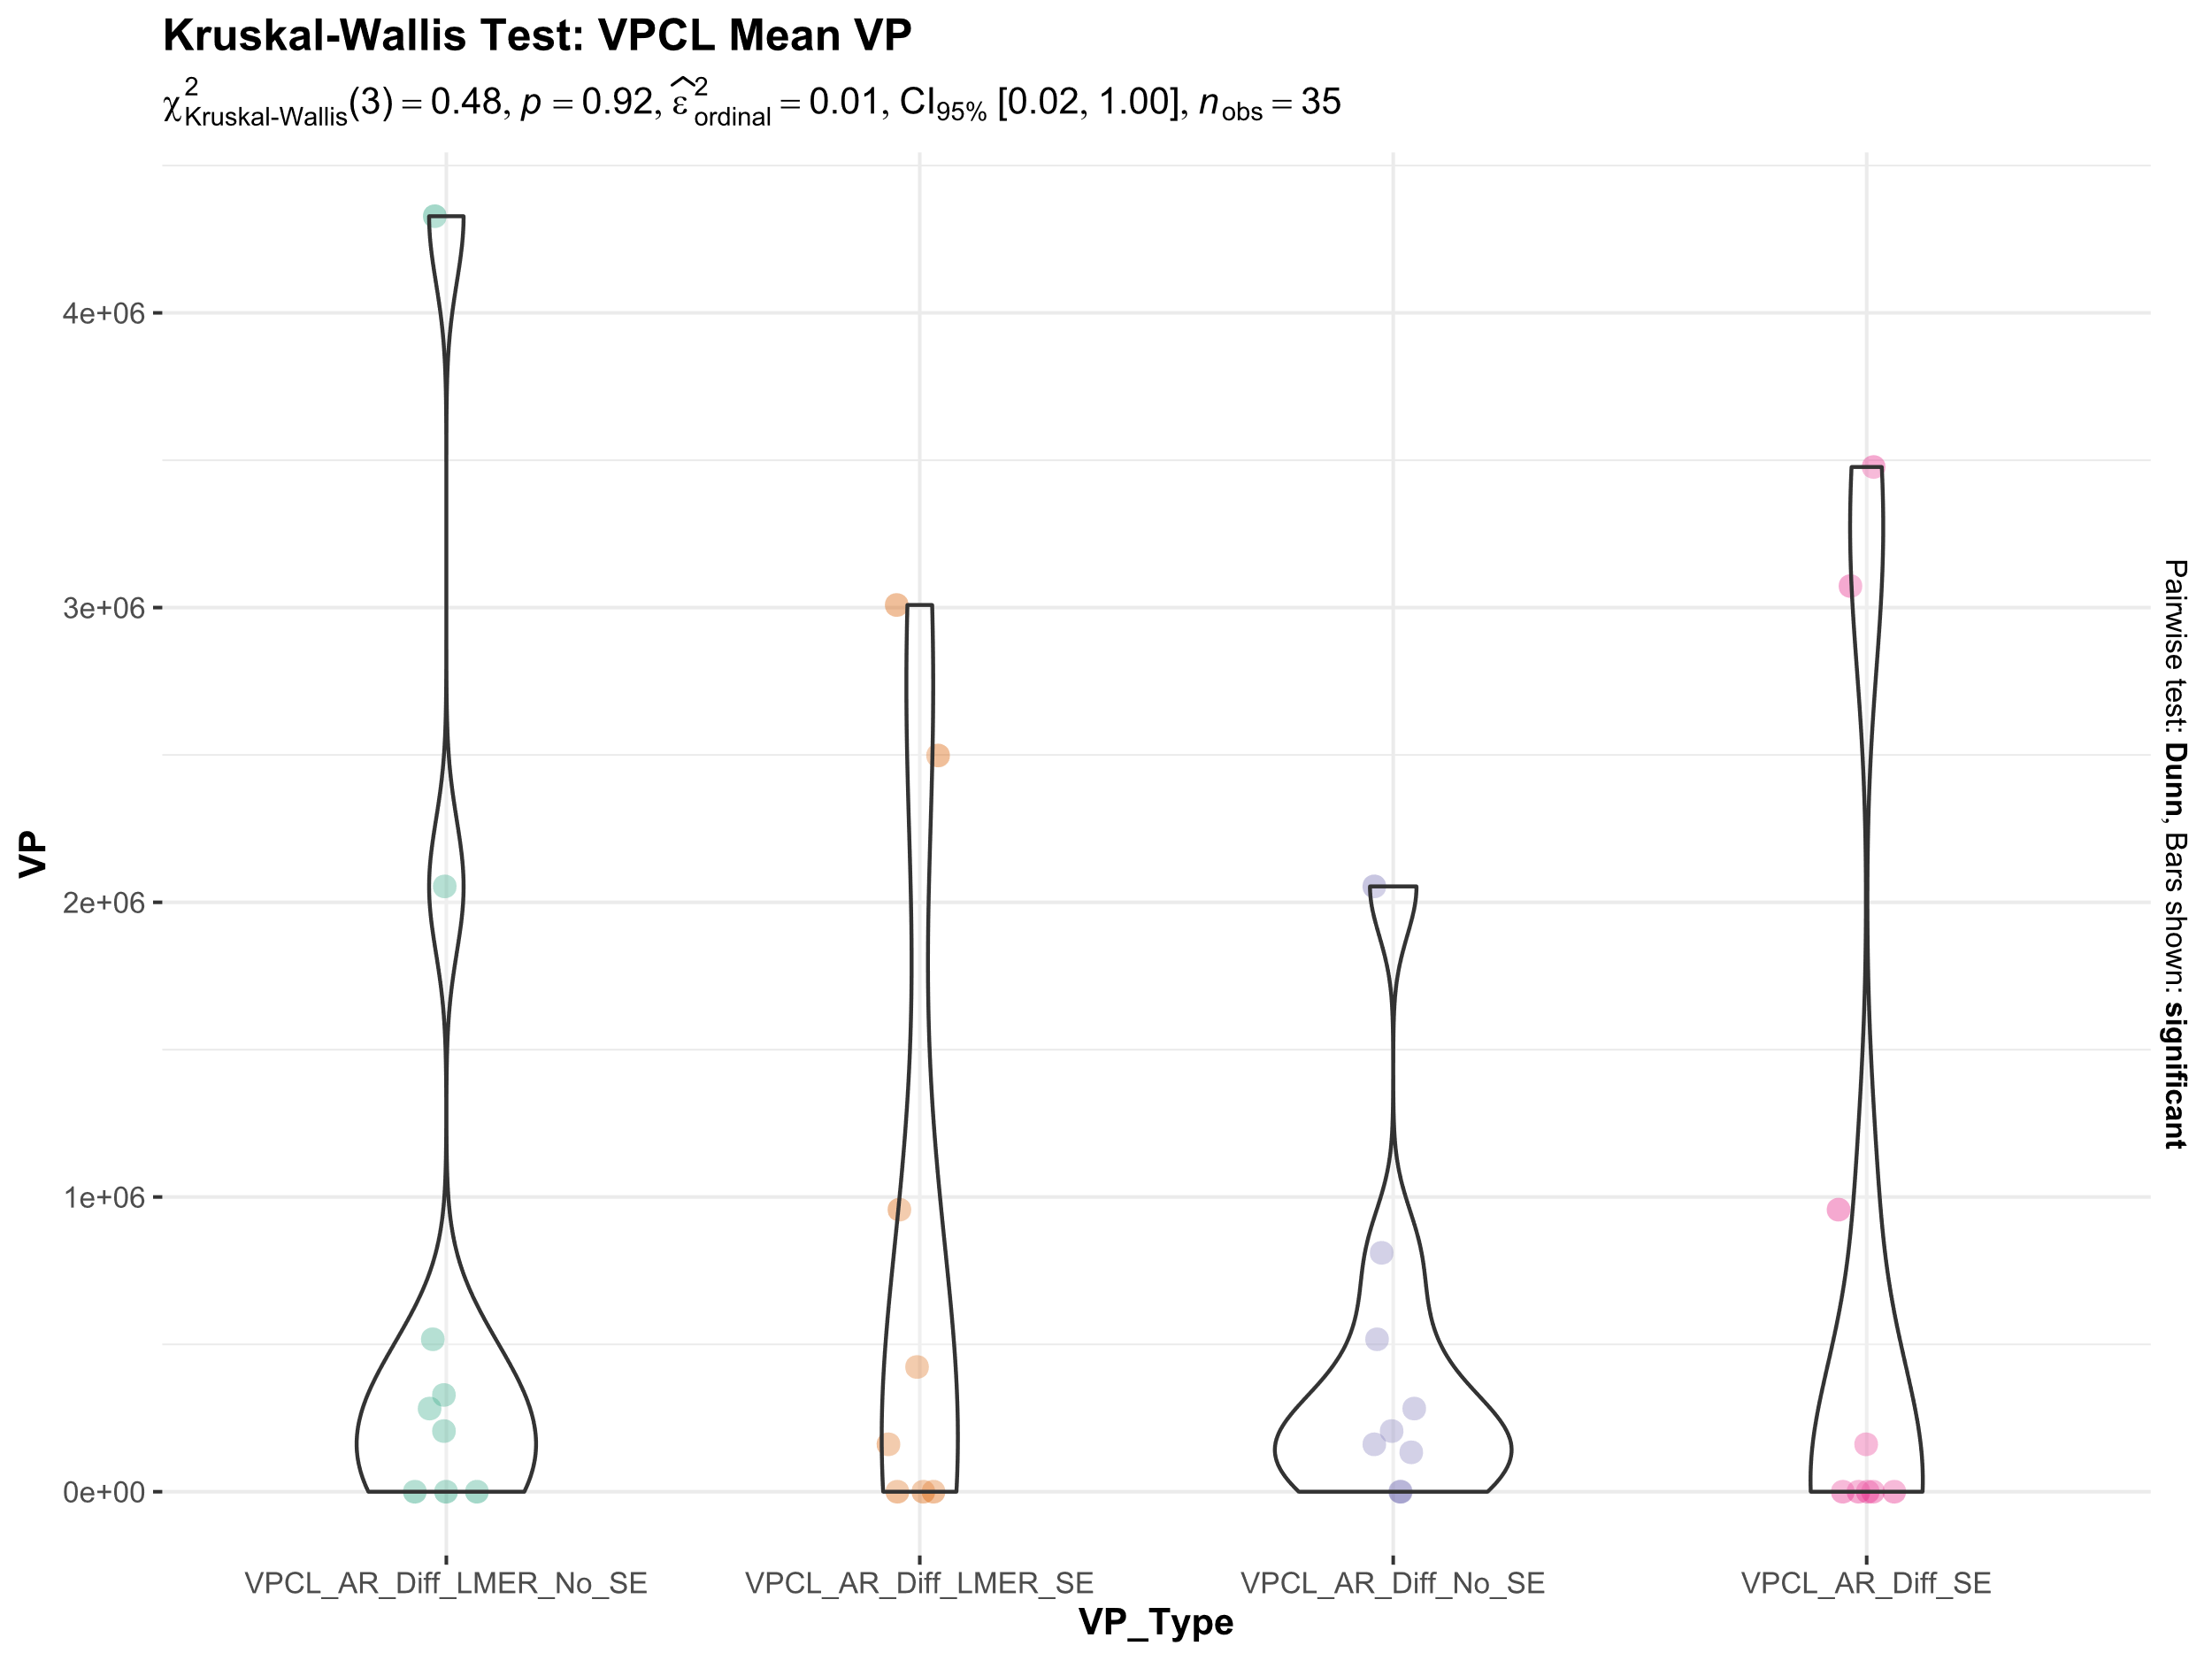
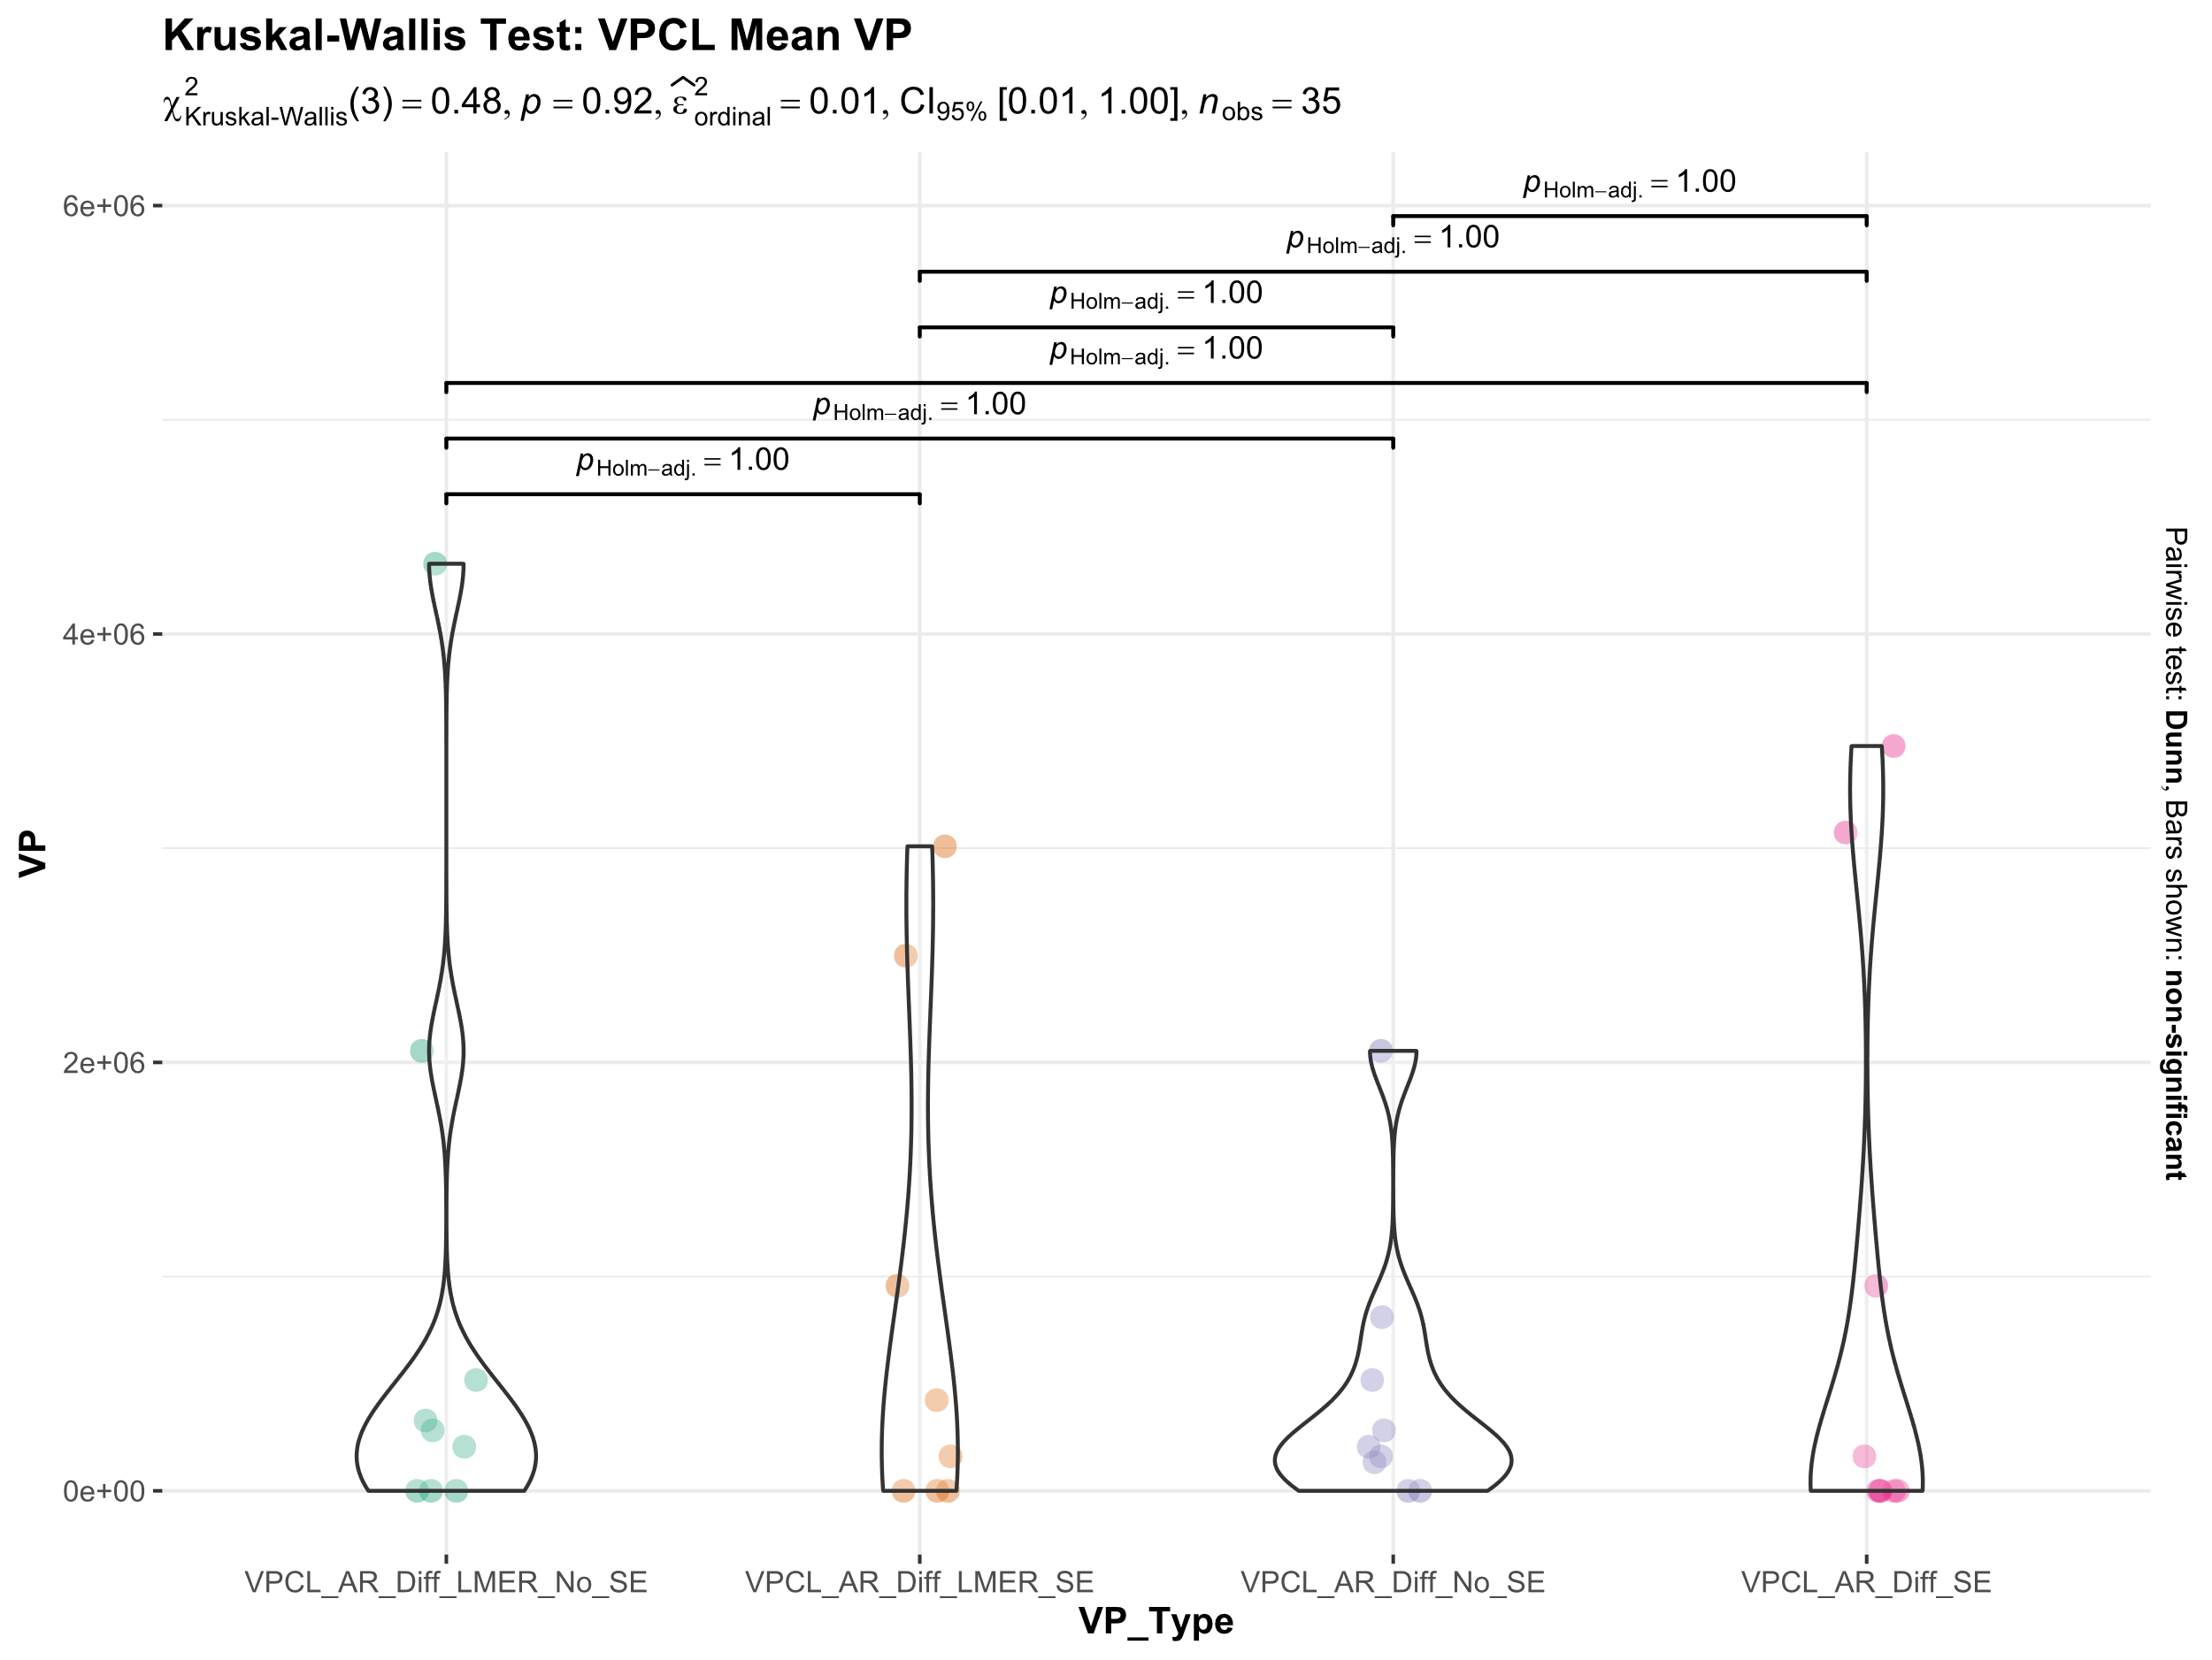

Slide 25
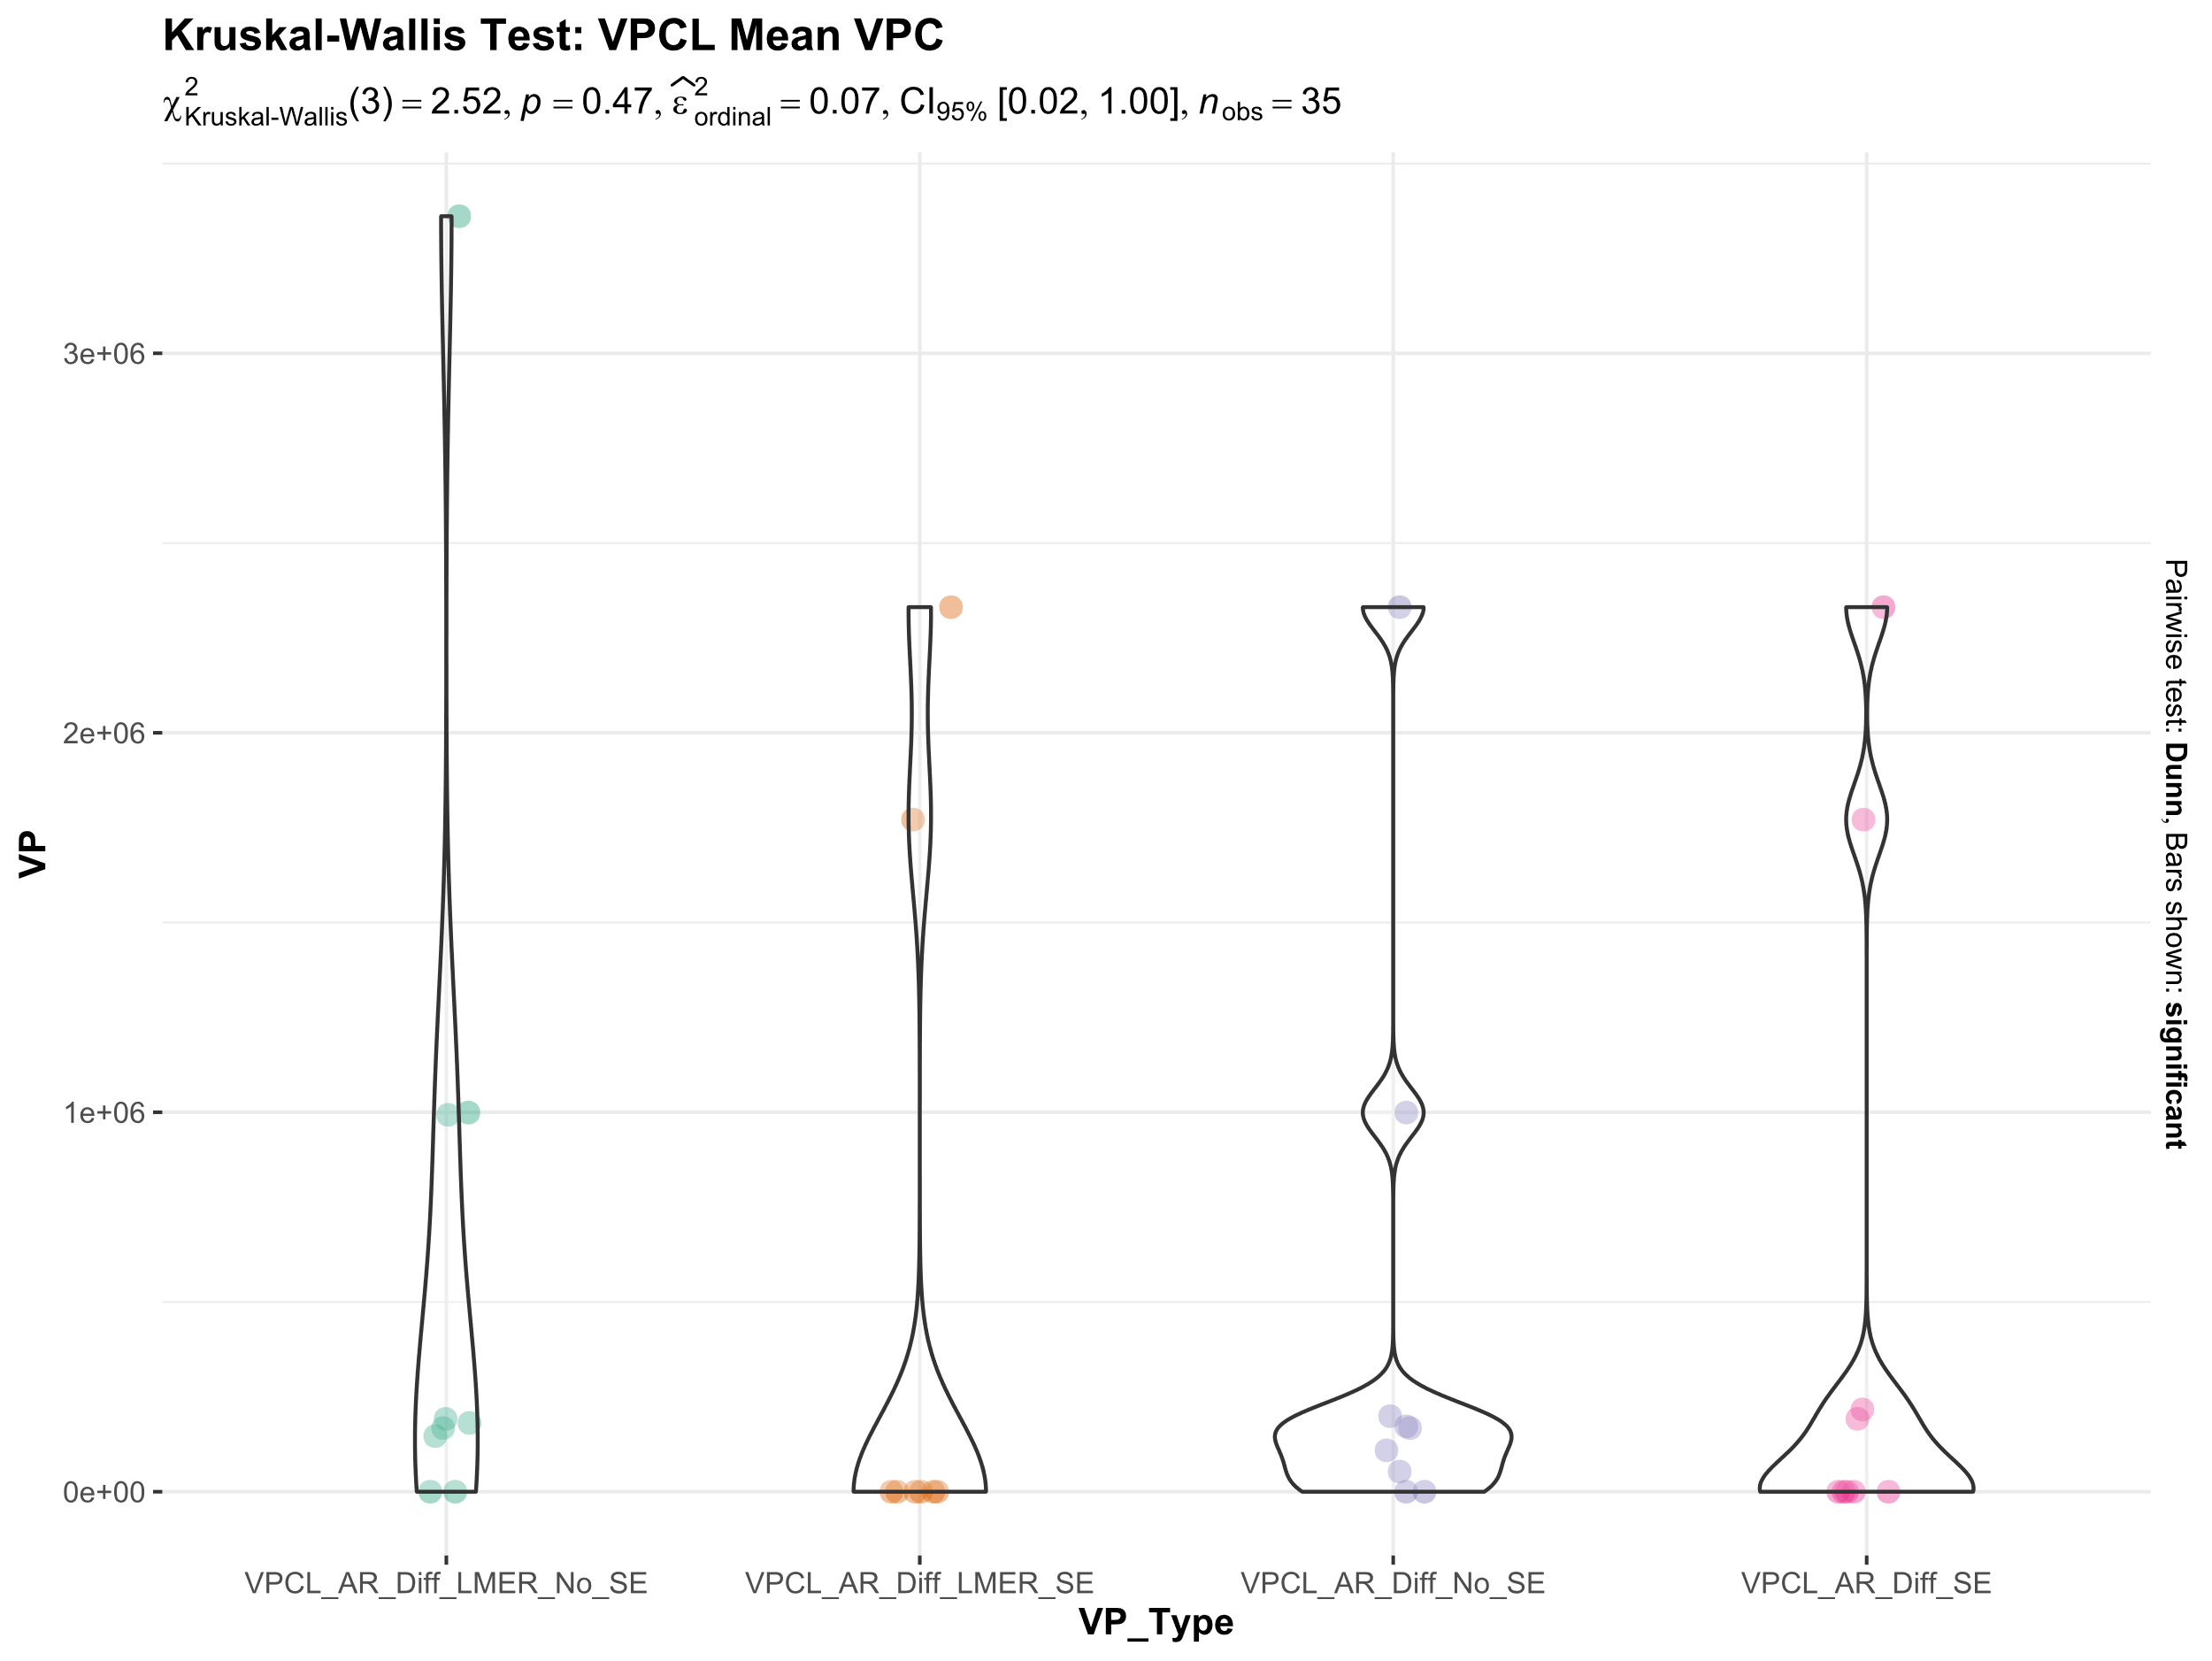
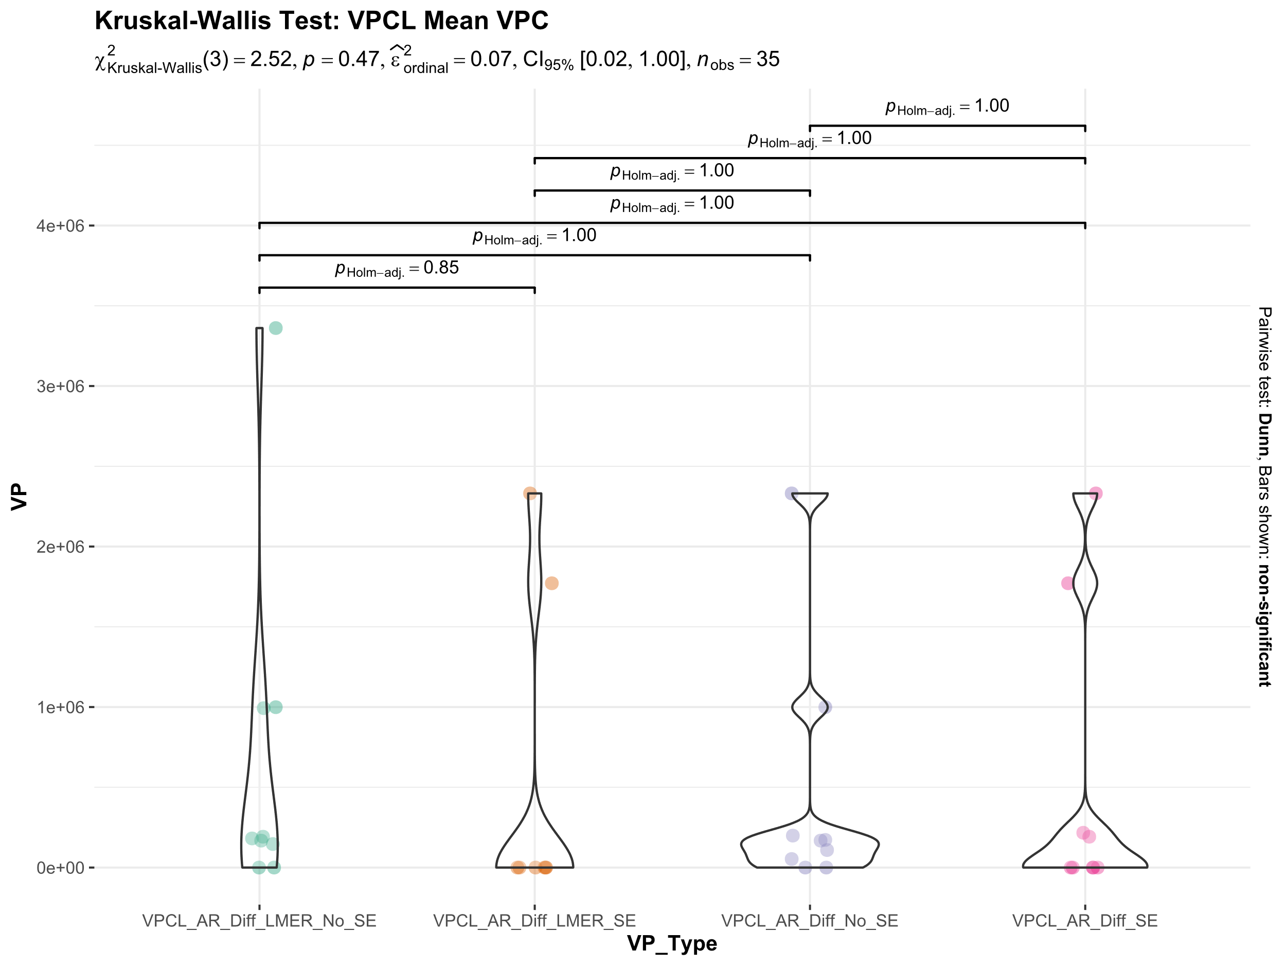

Slide 26
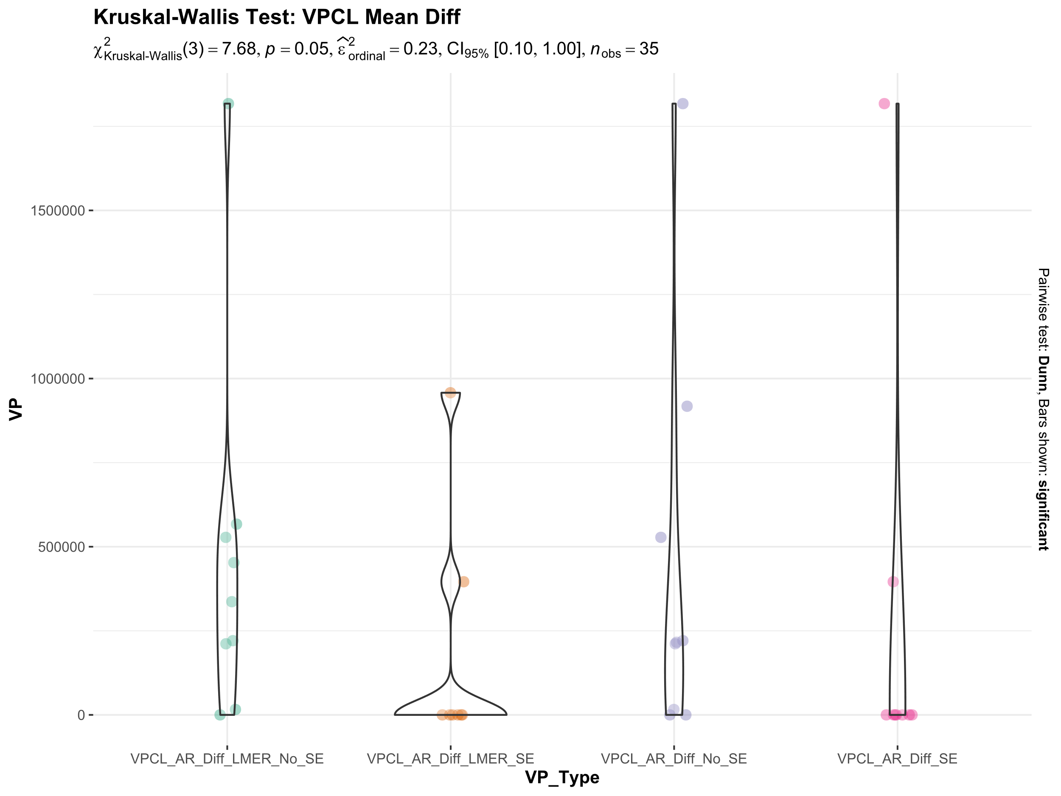
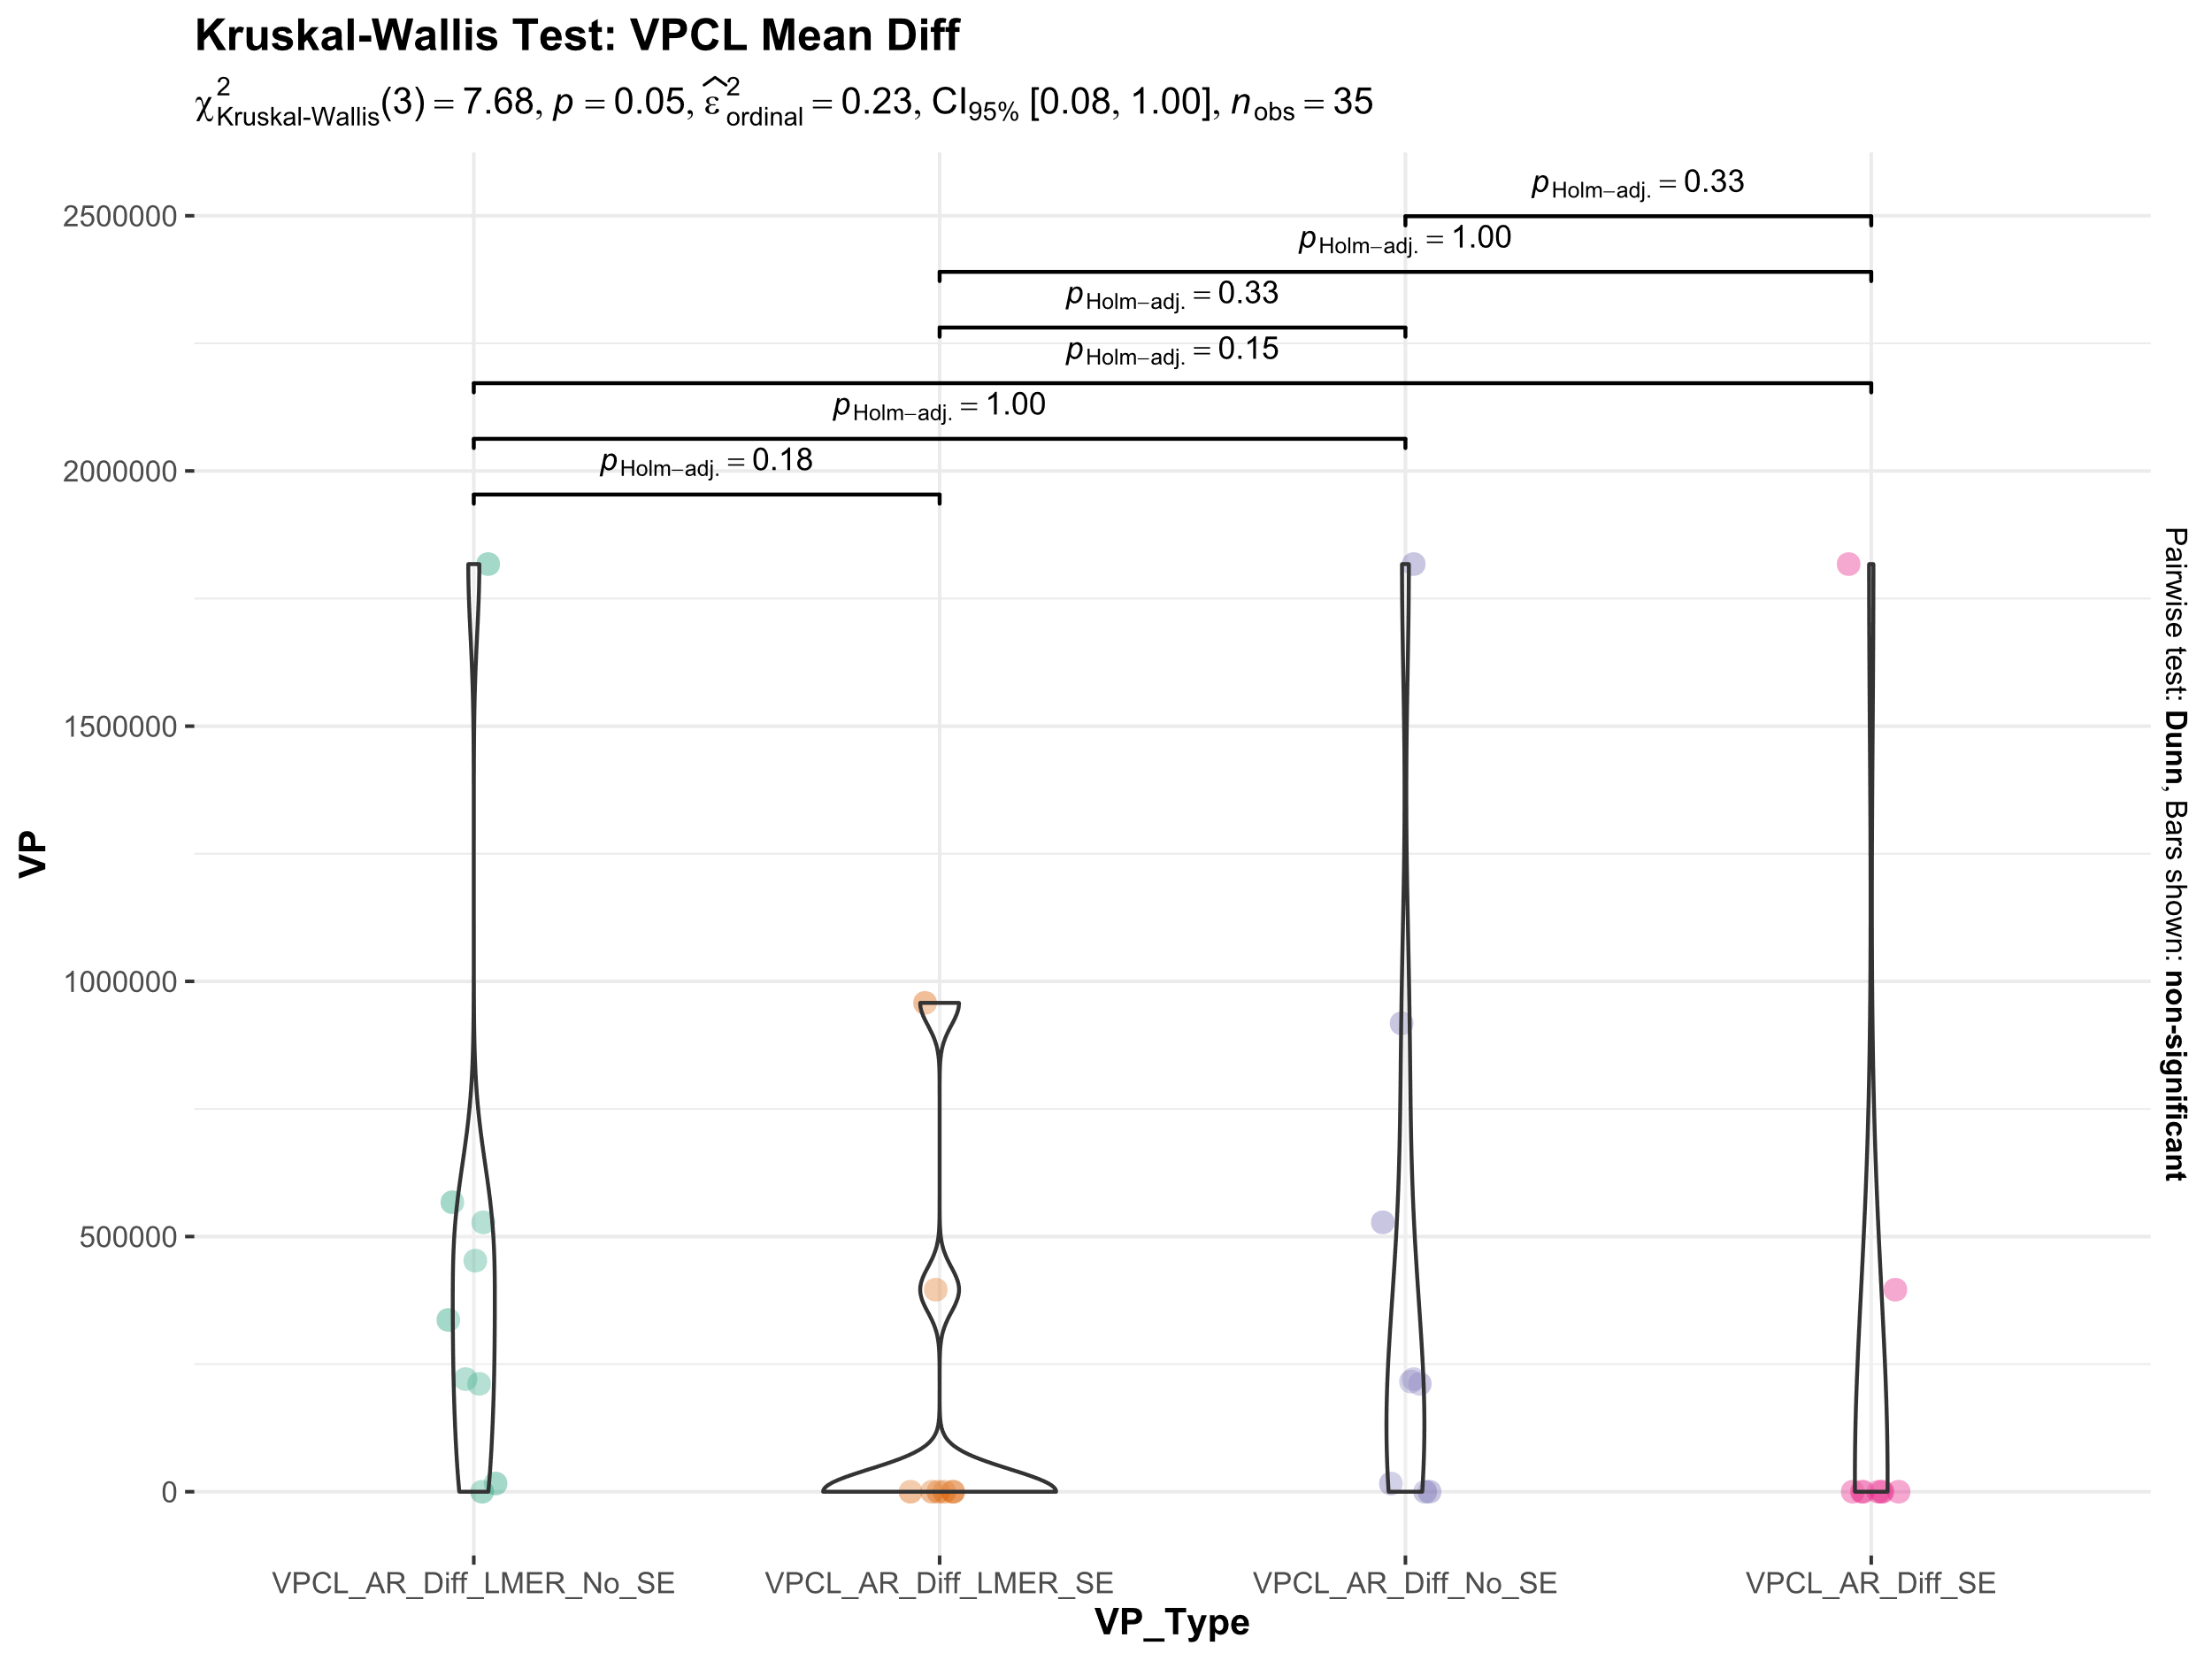

Slide 27
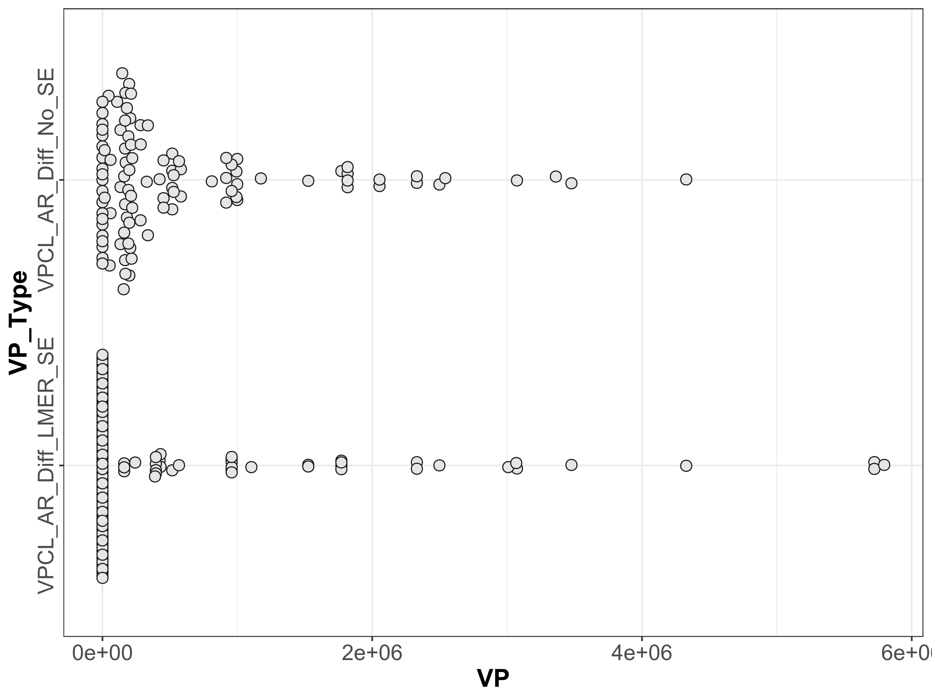
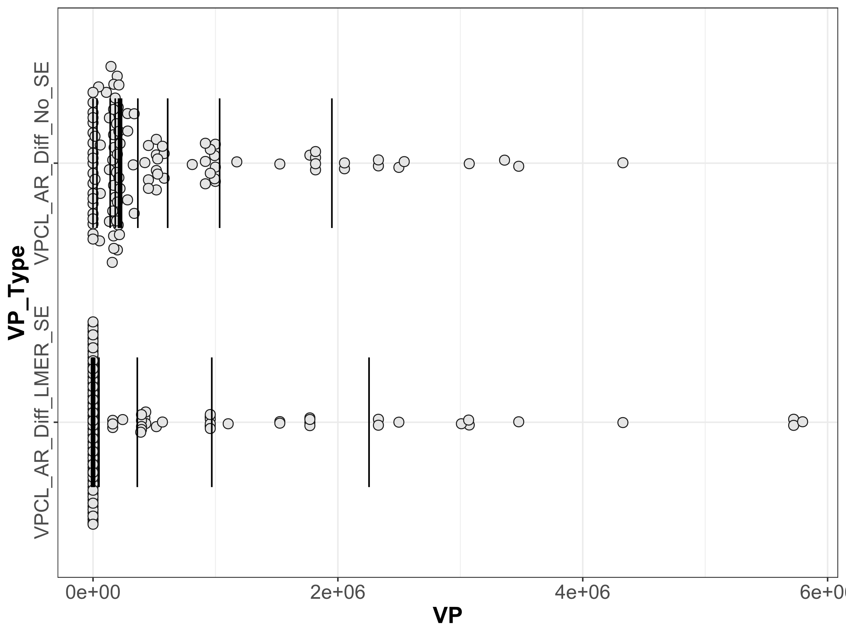

Slide 28
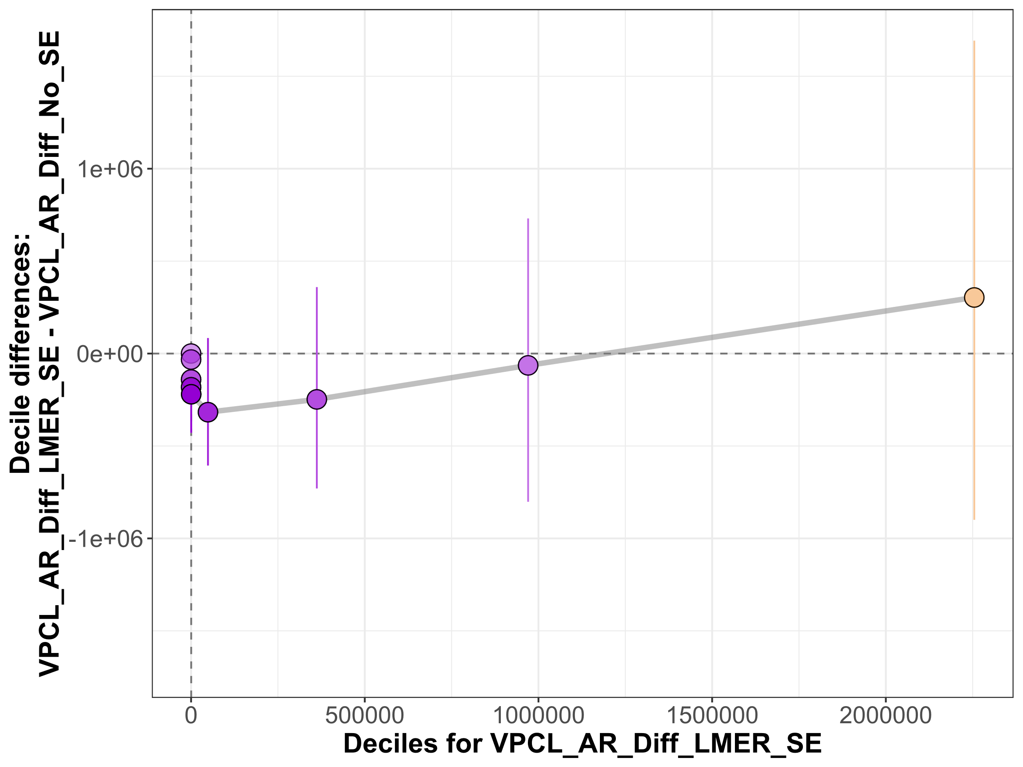

Slide 29
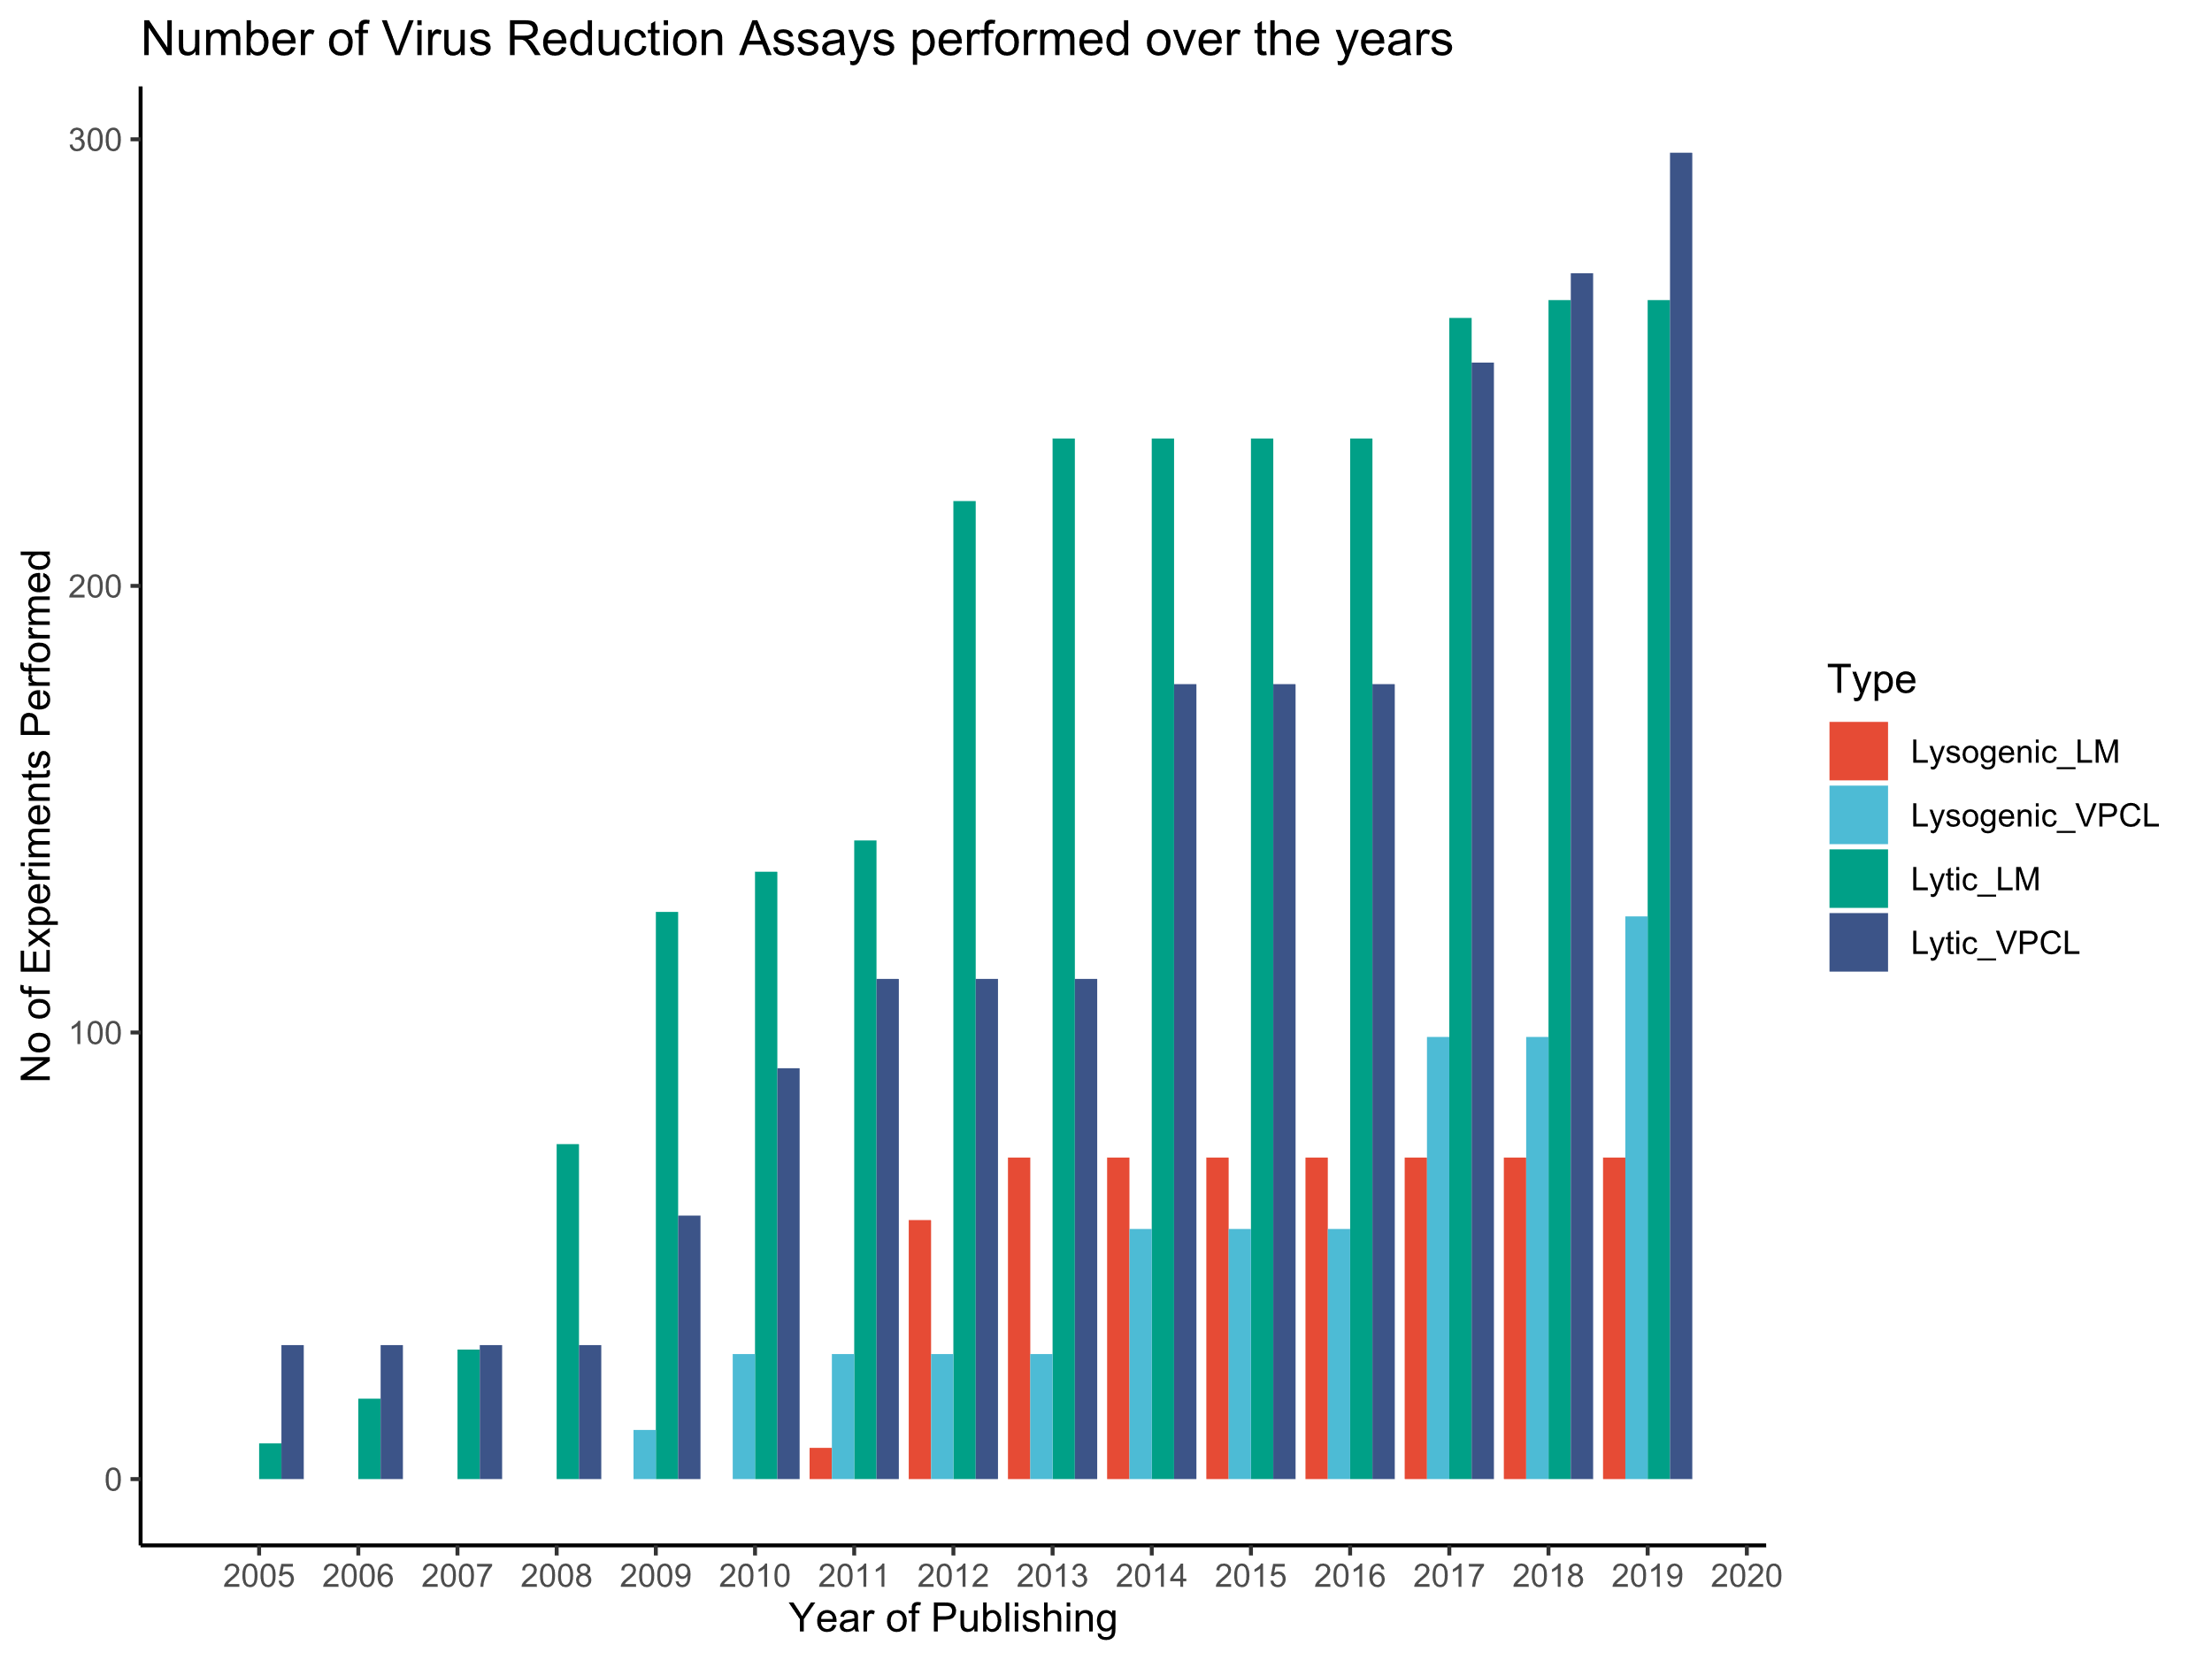

Slide 30
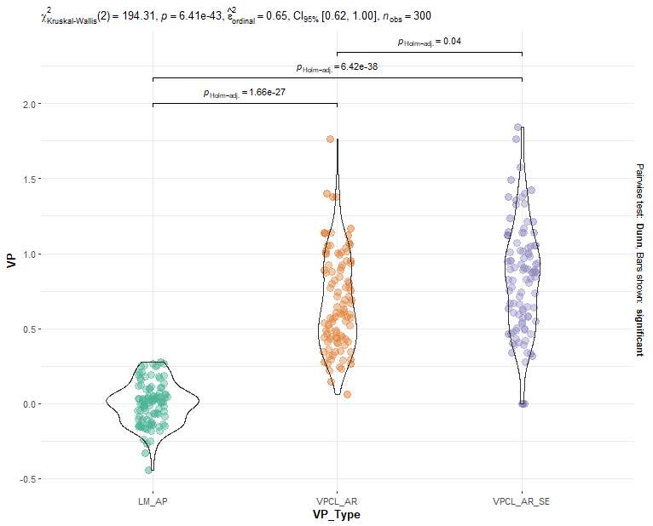
Simulation: 100 datasets

Slide 31
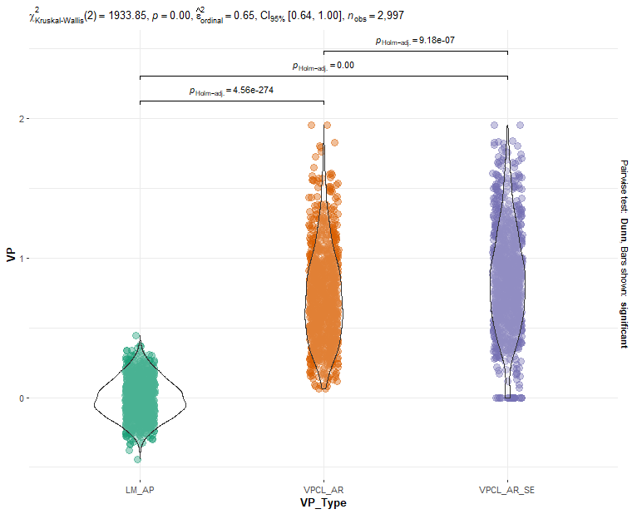
Simulation: 999 datasets

Slide 32
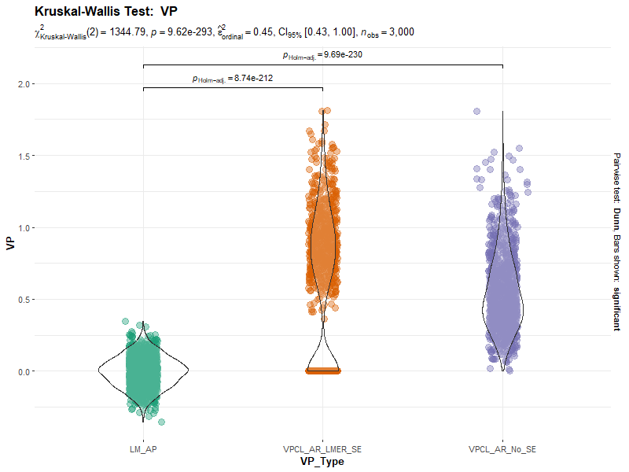

Slide 33
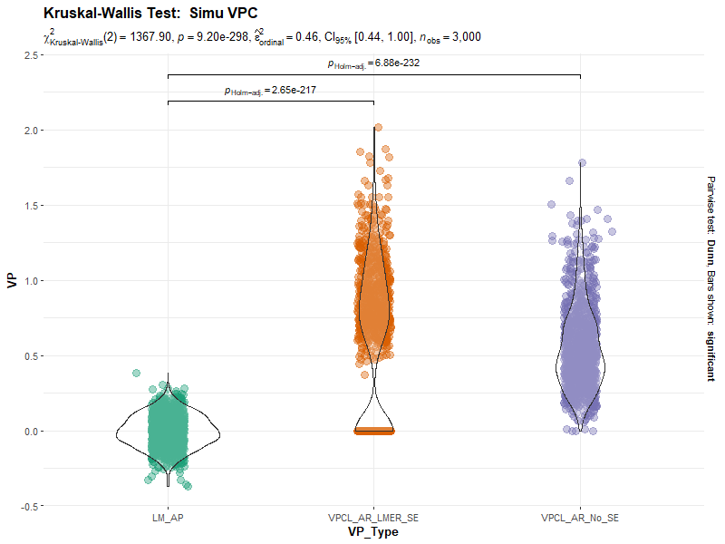

Slide 34
